Slide 1

A Wolf in Sheep’s Clothing:
Genre Blurring and Fake News
Joel Burkholder, jmb7609@psu.edu
@fromtheshelves
Kat Phillips, kec5013@psu.edu
@724PhillipsK

Slide 2
Objectives
Participants will:
identify how misinformation and disinformation borrow rhetorical techniques from authoritative genres to appear credible
learn and employ IF I APPLY, a tool for information evaluation to identify implicit and explicit biases in a text
Notes:
Outgrowth of our chapter in Teaching About Fake News and our research into how conceptualize the concept of bias
In order to achieve these outcomes – this will be an interactive webinar, we will be asking you to open a page in a browser and contribute via padlet

Slide 3

Activity 1: What makes this source seem like it is news?
You have 3 minutes to review this source and answer the question, “Why or why not is this source news?”
InfoWars SuperMoon Earthquakes
Post to Padlet: What specific features suggest that this source is news?
Notes:
Give a link and break out rooms, respond via padlet
What makes this source seem like it’s news?
https://padlet.com/kec5013/n5rrk0k4phtdln5

Slide 4
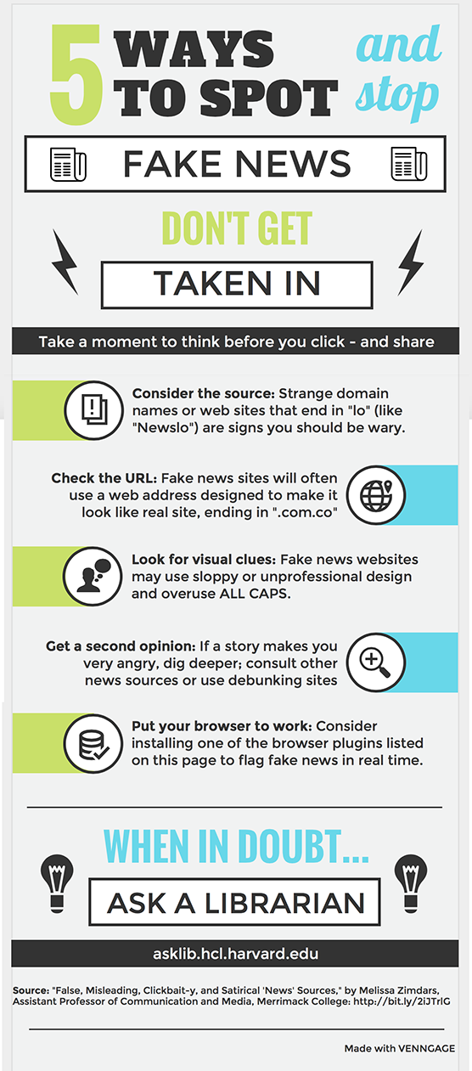
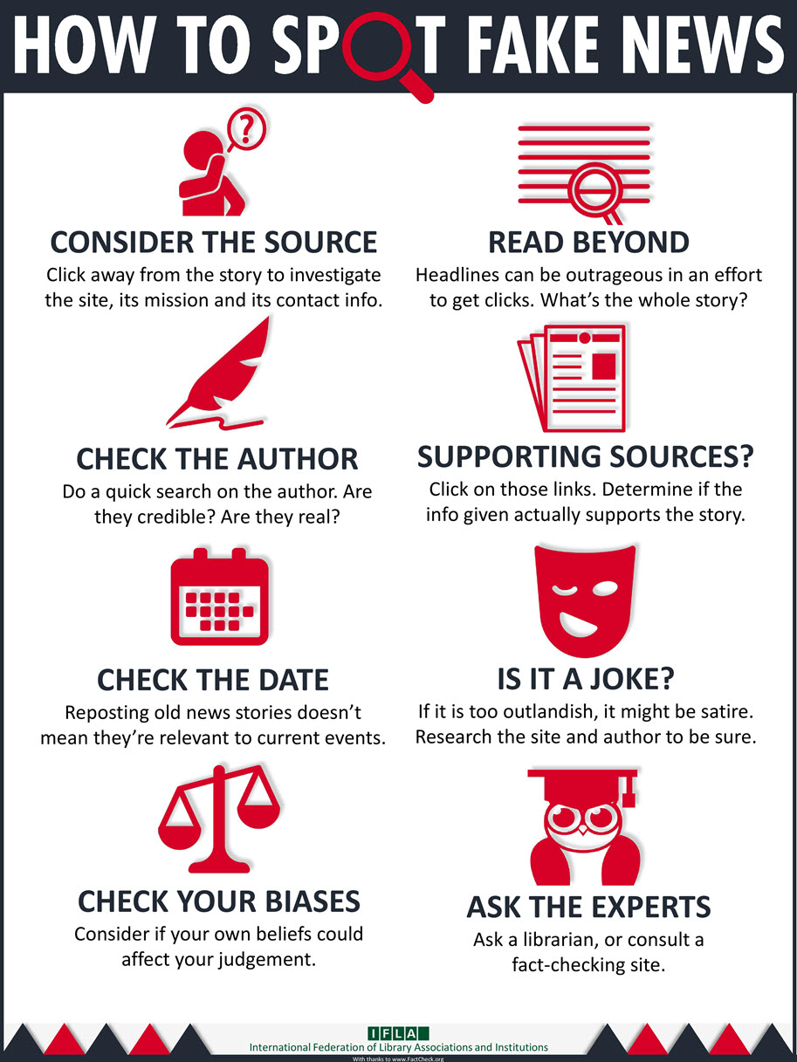
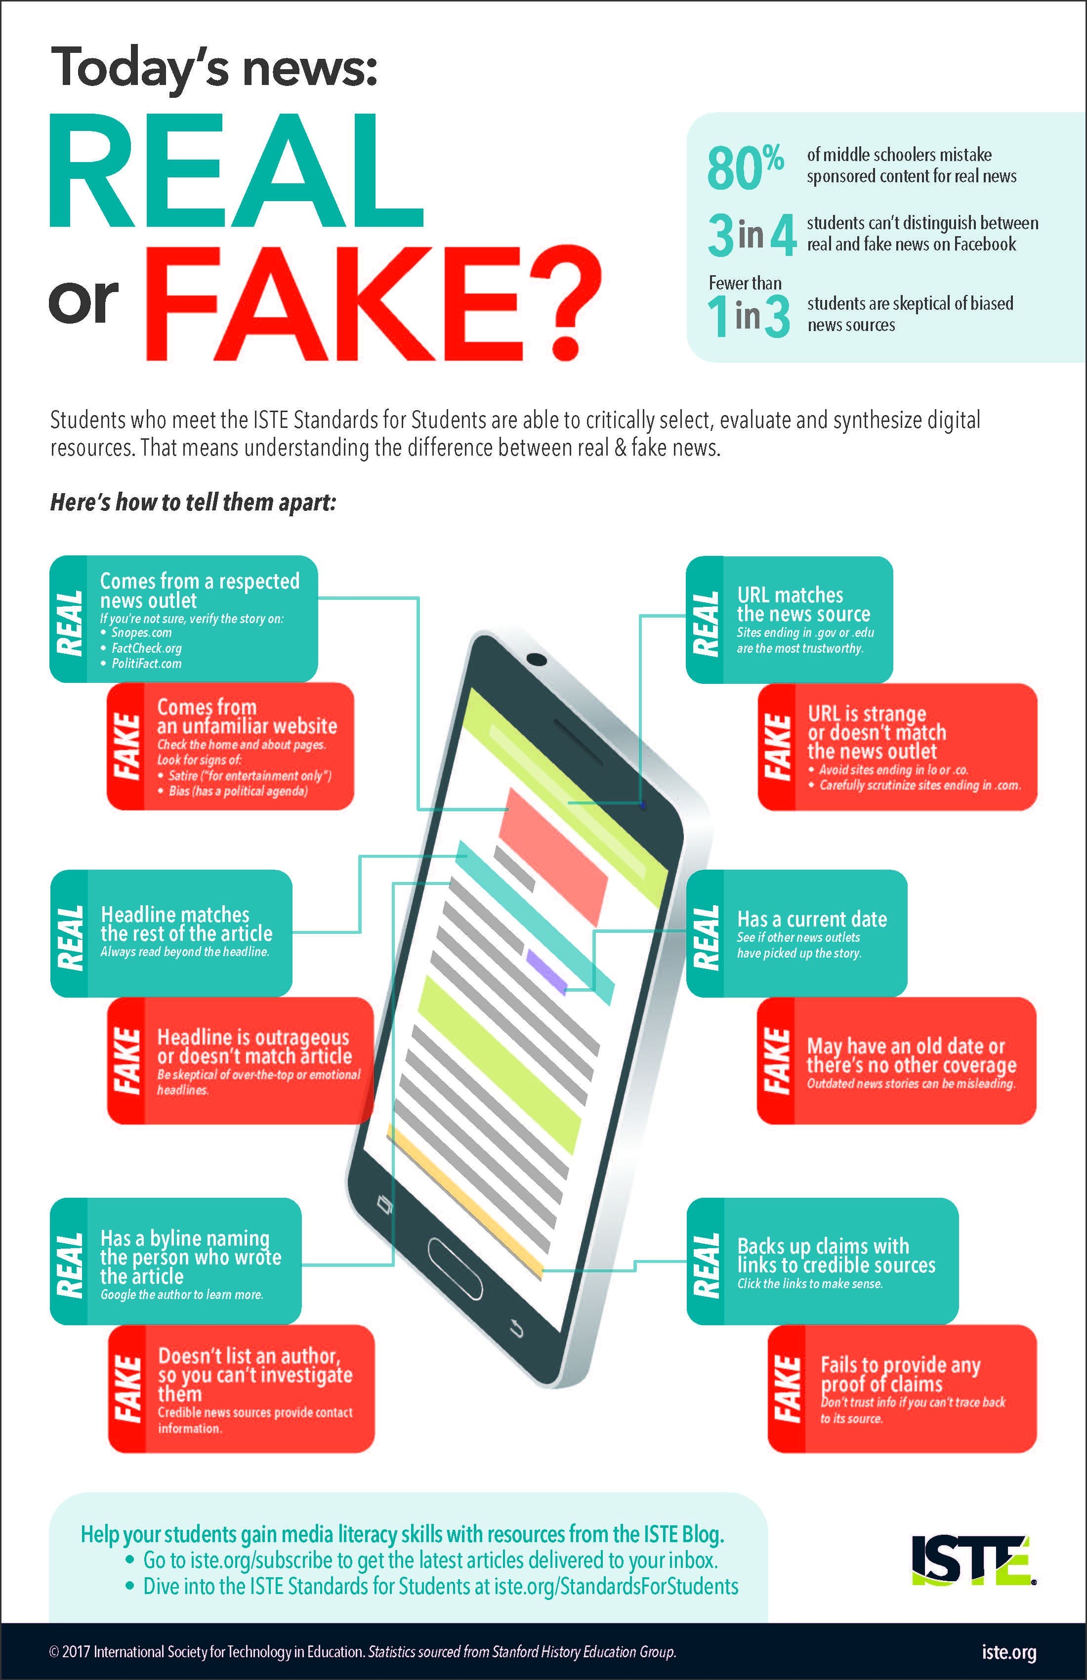
What do “Fake News” Infographics tell us?
Notes:
Stress that libraries typically have this high quality journalism and content
Two of these 3 resources say ask the experts\
Set a baseline of high quality of journalism or content as what other should be evaluated against – but what constructs that baseline
Assumes that people have an understanding of that baseline and the process behind it
What they don’t do is establish an evaluative process looking at process and purpose to help them understand features themselves
All are built on the assumption that people understand the process and creation of news
If we ask people to compare to a process that they do not understand, then the task is meaningless
None of these provide the context as to why this process is important for journalism
Checklists grossly oversimplify the process – unstated baselines – we don’t often teach the “news literacy” aspect of the issue (asking learners to compare to a baseline they don’t quite understand or just don’t know)

Slide 5
Genre Blurring
Borrowing of conventions to gain perceptions of authority and credibility
How does this specifically work with dis- or misinformation?
Notes:
“Borrowing the conventions blurs the boundaries between mainstream and fake news, granting the latter the perceptions of authority and credibility normally associated with the former.”

Slide 6
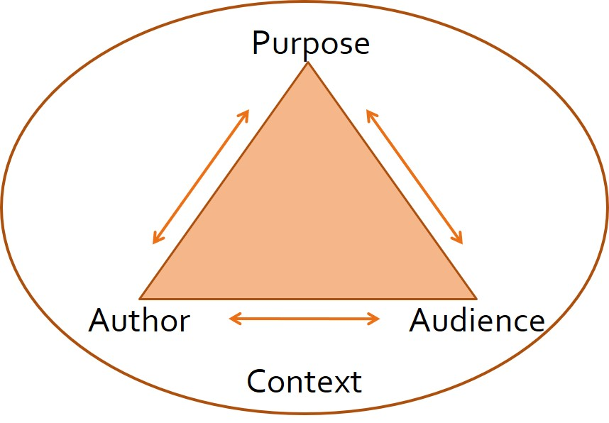
Rhetorical Approach to Source Evaluation
A means of analysis more reliant on purpose, and less on a checklist
Notes:
Everything is constructed. Assignments should help students understand the purpose behind that construction. Makes ideological demands of any situate explicit. Help them understand better what they are using.
Rhetoric, the study of how people use language to influence the behavior of others, emphasizes purpose.
The Elements of the Rhetorical Situation – Purpose: What are you trying to do? Audience: Who are you trying to influence and what are their expectations? Author: Who are you? Do you possess the necessary qualifications? Context: Conditions in which the communication takes place.
The interdependence of elements limit the choices available for constructing effective messages. What happens if a key part of the situation is missing? Different forms of communication—from clickbait to satire to conspiracies--are different in content and style because they allow writers to address different purposes and audiences.
Could examine how specific choices in examples of a type achieve purposes.
Must also be extended to academic genres

Slide 7
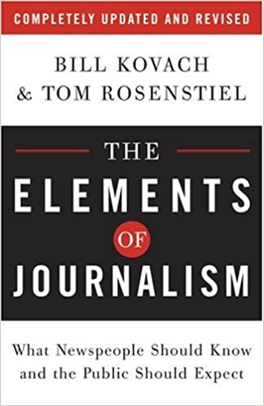
The Elements of Journalism
1st obligation is to the truth
1st loyalty is to citizens
Essence is a discipline of verification
Practitioners must maintain an independence from those they cover
Must serve as an independent monitor of power
Must provide a forum for public criticism and compromise
Must strive to keep the significant interesting and relevant
Must keep the news comprehensive and proportional
Practitioners must be allowed to exercise their personal conscience
Citizens have rights and responsibilities when it comes to the news
Notes:
While it borrows the mask of credibility – it does not meet these standards and elements
Because addressed in a totally different situation

Slide 8
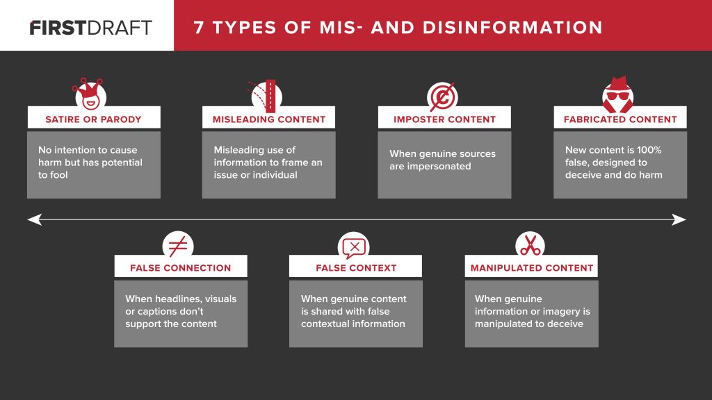
Misinformation and Disinformation (including fake news)
Bullets
https://firstdraftnews.org/latest/fake-news-complicated/
Notes:
Not a new problem
Questions the claims of news, by manipulating the conventions of fake news.
“In turn, this paper defines fake news as intentionally misleading and biased representational information for the benefit of the message sender, which contains false information, with or without a blend of one or more components of omitted important information, a decontextualized content, misleading headlines or clickbait.” S. Lim The Journal of Academic Librarianship 46 (2020)
“This article studies the construction of fake news titles and articles, concluding their structure (e.g., lots of words in titles, emotionally fraught word choice, simple and repetitive content in the body) tend to manipulate cognitive biases in target audiences. Horne and Adali
PLANDEMIC VIDEO
Chemtrails information

Slide 9
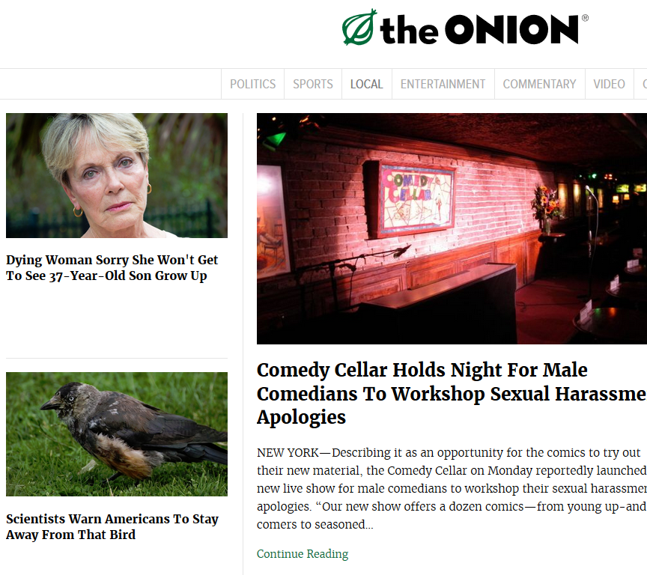
Satire or Parody
Notes:
Manipulate journalistic standards for humor; depend on readers understanding them for full effect
Onion is the most obvious example, but there are tons; not all for are forthcoming about their satire status (need to dig, but that’s often more effort than many exposed to story expend)
Parody accounts on social media

Slide 10
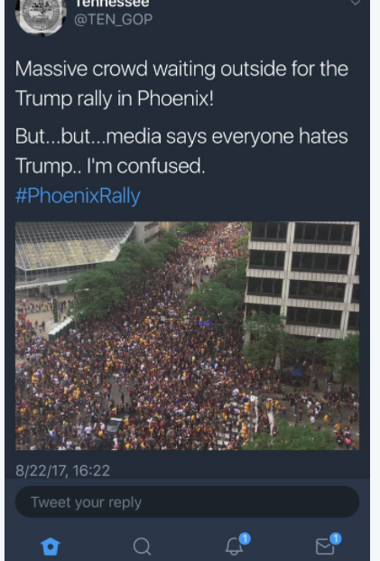
False Context
Notes:
Context is a vital part of every story. It informs what’s valuable and meaningful to understanding the scope of a story. Part of “seeking truth and reporting it.”
That said, it’s easy to ignore when making a biased point. Can be an image, a tweet, a story, etc.
Image isn’t from rally in Phoenix; it’s Cleveland. And those are Cavaliers fans celebrating their 2016 NBA Championship, not Trump supporters.
Memes, again, are excellent examples; to simplify an argument it much ignore context.

Slide 11
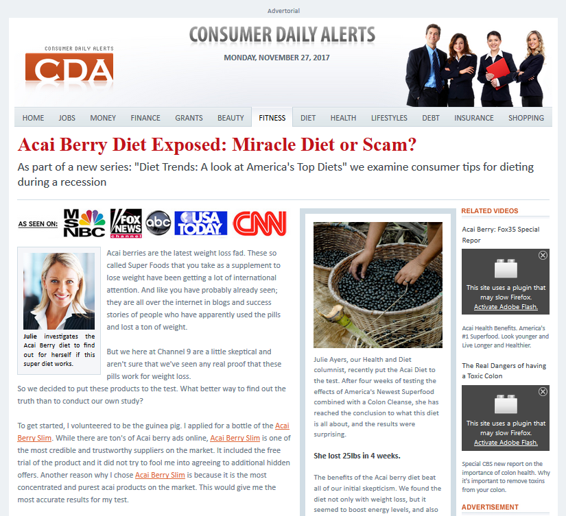
Imposter Content
Notes:
Borrows features of traditional news reporting to establish credibility; purpose is often to sell something
Native advertising is an obvious example
No truthful or independent or transparent

Slide 12
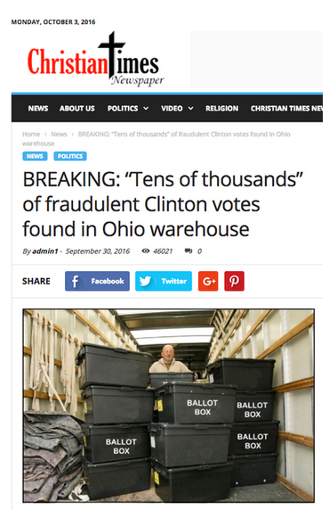
Fabricated Content
Notes:
After election, New York Times profiled Cameron Harris, who admitted to making up this story. Quote: “Given the severe distrust of the media among Trump supporters, anything that parroted Trump’s talking points people would click. Trump was saying ‘rigged election, rigged election.’ People were predisposed to believe Hillary Clinton could not win except by cheating.”
Make money and as we’ve learned more about Russian interference, to sow dissension.
Tweets
YouTube Videos
Comments on legitimate news stories
Borrows surface features, but doesn’t not adhere to any journalistic standards

Slide 13

Conventions of Journalism
Corrections
Sourcing
Quotes
Reflecting reality
Datelines and bylines
Attribution
Reporting rumors
Graphic images and obscenities
https://handbook.reuters.com/index.php?title=Accuracy
Notes:
https://www.bbc.co.uk/bitesize/guides/zy4rfrd/revision/1 - Warning: Video contains strong language and the animated beheading of a lighthouse keeper
Structural conventions rather than how a newspaper would necessarily work

Slide 14
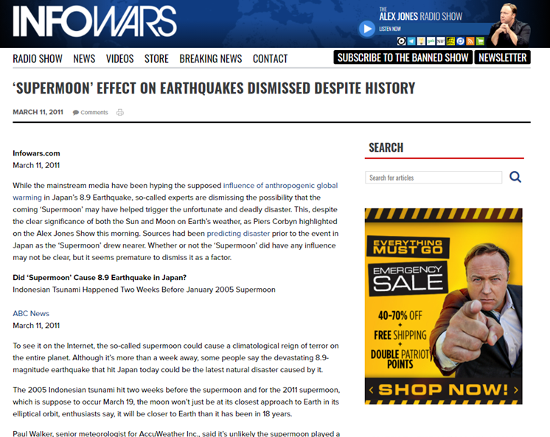
Let’s Discuss:
InfoWars
Notes:
Go back to the padlet answers to structure this conversation
It appears to perform vs. the function it is performing
Bring back in the Padlet responses

Slide 15
Confirmation & Cognitive biases
Confirmation bias: the tendency to look for information that supports, rather than rejects, one’s preconceptions, typically by interpreting evidence to confirm existing beliefs while rejecting or ignoring any conflicting data
Cognitive bias: a systematic error in thinking that occurs when people are processing and interpreting information in the world around them and affects the decisions and judgments that they make
Notes:
Types of confirmation bias: Biased Search for Information; Biased Interpretation; Biased Memory
Types of cognitive bias: Actor-observer bias; Anchoring bias; Halo effect; Misinformation effect; The Dunning-Kruger effect
Cognitive bias is rooted in thought processing errors often arising from problems with memory, attention, attribution, and other mental mistakes.

Slide 16
IF I APPLY
Address Cognitive Bias
Assess the Source
Identify emotions
Find unbiased sources
Intellectual courage to seek other authoritative voices
Authority
Purpose/Point of View
Publisher
List of sources
Year of publication
#ifiapply
Notes:
Fake new’s problem is that if you’re tricked into believing it is true, your cognitive/confirmation biases lead to your belief that it is true
We can’t ignore the predisposition that you have coming into the evaluation of a resource

Slide 17
Critical Thinking with IF I APPLY
IF I
APPLY
What are your honest opinions regarding the topic?
Make an all-inclusive list of counter-opinions or counter-arguments.
Reject unsound arguments - have the courage to accept that not all viewpoints are valid
Are any conclusions offered? If so, based on what evidence and supported by what primary and secondary documentation?
Are diverse perspectives represented?
Is the content relevant to your information needs?
Is this information authentic?
Is this information unique or has it been copied?
#ifiapply

Slide 18
How could cognitive or confirmation biases factor into the selection and evaluation of a blog post?
Are you familiar with “Food Babe”?
  If so, what automatic reaction did you have when you heard “Food Babe”– did your familiarity set you off on a pro-source or anti-source foot?

Slide 19
Activity 2
These Hired “Experts” Are Infiltrating The Media To Confuse You About Food…
IF I APPLY – Quick application
  Do you believe that authority(ies) is/are present? Why or why not?
  Is this information authentic and complete? How or how not?
Put yourself in the shoes of someone interacting with this source…
  What news-like elements may lead to perceptions of authority and credibility?
Notes:
https://padlet.com/kec5013/9zrqza0y95vrgh94

Slide 20

Questions
Comments
Compliments
Concerns
Joel Burkholder, jmb7609@psu.edu
@fromtheshelves
Kat Phillips, kec5013@psu.edu
@724PhillipsK
#ifiapply

