Slide 1
Deconstructing Environmental Conflict: Bias, News, and Perspective
:
Sharon Radcliff, Librarian, CSU East Bay
PLA Presentation, 2018,

Slide 2
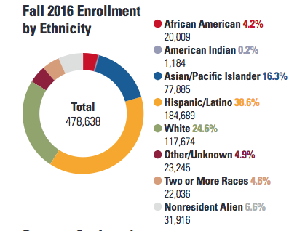
CSU East Bay: Demographics
No 1 in Diversity for mainland universities https://www2.calstate.edu/csu-system/about-the-csu/facts-about-the-csu/Documents/facts2017.pdf

Slide 3
Information Literacy & Environmental Conflict & Sustainability
One-two Unit course on Information Literacy
Developed case study assignments related to environmental conflict
Through the lens of sustainability
Exploring bias, including “myside bias”, bias in news, & perspective through analysis of argument, evidence, purpose & tone.

Slide 4
What is Sustainability?
In 1987, the UN Brundtland Commission defined sustainable development as "meeting the needs of the present without compromising the ability of future generations to meet their own needs." (Report of the World Commission on Environment and Development.)Jan 10, 2008
Or put more simply: “Live today as if there is a tomorrow!” (quote from Geoffrey Chase, provost CSU CHannel Islands)
Key Organization for Integrating Sustainability into Higher Education:
AASHE: http://www.aashe.org/

Slide 5
Components of a Sustainable Future (From AASHE Conference)
Healthy
Environment
Social Health
Social Justice
Flourishing
Economy
Sustainable Society

Slide 6
A better view? (From AASHE)
Rather then the three partially connected circles shown on the previous slide, a better picture of a sustainable community is the circles within circles show below
Environment
Society
Economy
A view of community as three concentric circles: the economy exists within society, and both the economy and society exist within the environment.

Slide 7
System goals could include the following: From AASHE Conference CSU Channel Islands
Ecological system goals
Genetic diversity
Resilience
Biological productivity
Economic system goals
Increasing production of goods and services
Satisfying basic needs or reducing poverty
Improving equity
Social system goals
Cultural diversity
Social justice
Gender equity
Participation
Environmental
Systems
Economic
System
Social
System
Unsustainable
development
Sustainable development
(in the interactive zone)

Slide 8
Case Studies in Environmental Conflict:
Include environmental, social justice and economic components, often at odds
By examining claims, evidence, and backing or values/world view behind claims, one can better understand conflicts and biases.

Slide 9
Case Study Approach:
Examines one problem in depth
Contains all of the three “E”s
Analyzes stakeholder perspectives
Integrates critical thinking
Includes analysis of background, bias of stakeholders and evaluation of evidence and sources of information
Analyze multiple perspectives
May incorporate dialectical view of argument

Slide 10
CSU East Bay ILO: Sustainability Overlay
After completion of a course designated as fulfilling the Sustainability Overlay requirement, students will be able to:
Identify the environmental, social, and economic dimensions of sustainability, either in general or in relation to a specific problem;
Analyze interactions between human activities and natural systems;
Describe key threats to environmental sustainability; and
Explain how individual and societal choices affect prospects for sustainability at the local, regional, and/or global levels.

Slide 11
Framework for Information Literacy
Research as Inquiry
Scholarship as a Conversation
Authority is Constructed and Contextual

Slide 12
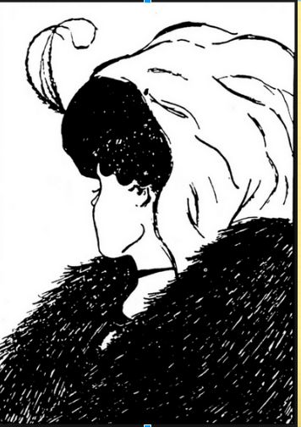
Pre-work on Bias
What
Do you
See?

Slide 13
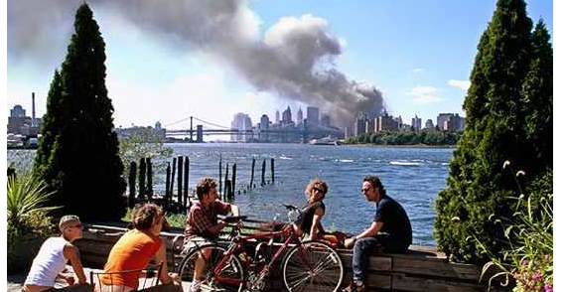
What do you see?
Notes:
Talk about the assumptions we make about the people in the picture given the background; discuss the photo’s controversy and how the people claimed they were feeling at the time.

Slide 14
Interpretations could be wrong!
Photo taken by Hopkner
Subjects dispute ”callous” interpretatione
http://www.slate.com/articles/news_and_politics/culturebox/2006/09/its_me_in_that_911_photo.html

Slide 15
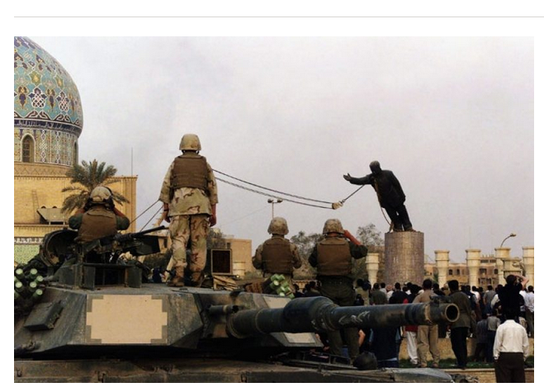
What do you see?

Slide 16
April 2003
Toppling of Saddam statue: Propaganda or reality?
It did happen, but most of the crowd were reporters not Iraqi citizens

Slide 17
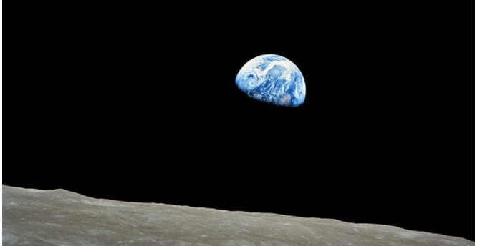
What do you see?
Notes:
Discuss how the impact of this picture changed as views of the earth went form none to many over time.

Slide 18
First Earth rise photo
Apollo 8, the first manned mission to the moon, entered lunar orbit on Christmas Eve, Dec. 24, 1968. That evening, the astronauts-Commander Frank Borman, Command Module Pilot Jim Lovell, and Lunar Module Pilot William Anders-held a live broadcast from lunar orbit, in which they showed pictures of the Earth and moon as seen from their spacecraft. Said Lovell, "The vast loneliness is awe-inspiring and it makes you realize just what you have back there on Earth." They ended the broadcast with the crew taking turns reading from the book of Genesis.
Image Credit: NASA

Slide 19
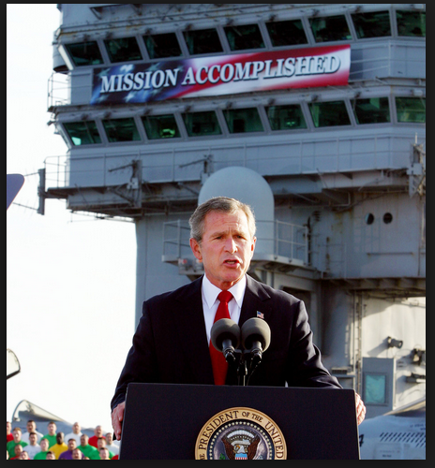
What is represented here?

Slide 20
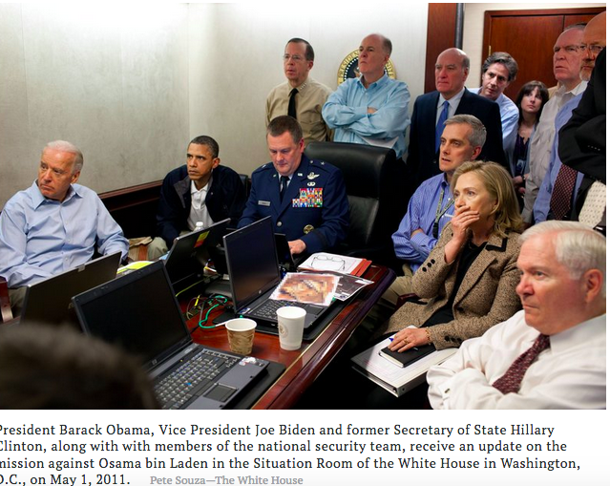
Mission Accomplished

Slide 21
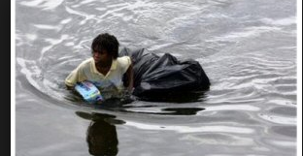
Describe each photo
(This was after Hurricane Katrina)

Slide 22
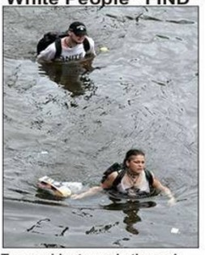
Also After Hurricane Katrina

Slide 23
Racial Profiling: Looting & Finding
http://www.latimes.com/nation/la-na-harvey-20170829-story.html
“The controversy centered on two photos and their respective captions. One from Associated Press photographer Dave Martin showed a young black man wading through water while holding a bag and a case of soda. The accompanying description stated that he was "looting." A second photo from Chris Graythen for Getty Images showed a similar scene, but this time it was a white couple clutching bags of food. Their actions were labeled as "finding."

Slide 24
Review of Argument
Claim supported by evidence linked with logic (or a reason) to the claim
Counter-arguments are
Integrated into claim or rebutted with a new claim
Backing supports evidence and the reasoning connecting the evidence to the claim

Slide 25
Developing an Argument
Often begins with investigating a topic
Coming up with a hypothesis
Exploring and testing the hypothesis against the evidence
Modifying your hypothesis
Creating a claim and backing it with evidence
Considering alternative and/or opposing viewpoints

Slide 26
First step in researching or investigating a topic: Ask what do I know?
Sample topic:
Effect of television violence on aggressiveness in children.
Some questions to ask:
What do I already know about this topic?
What do I already believe about this topic?
Do I think television does or does not affect behavior in children?

Slide 27
Am I biased?
Sometimes what I know or believe about a topic may
create tunnel vision as I do my research.
For example if I believe violence on TV does cause aggression in children I may pay more attention to research that supports this than research that disputes this or offers alternative perspectives on it.

Slide 28
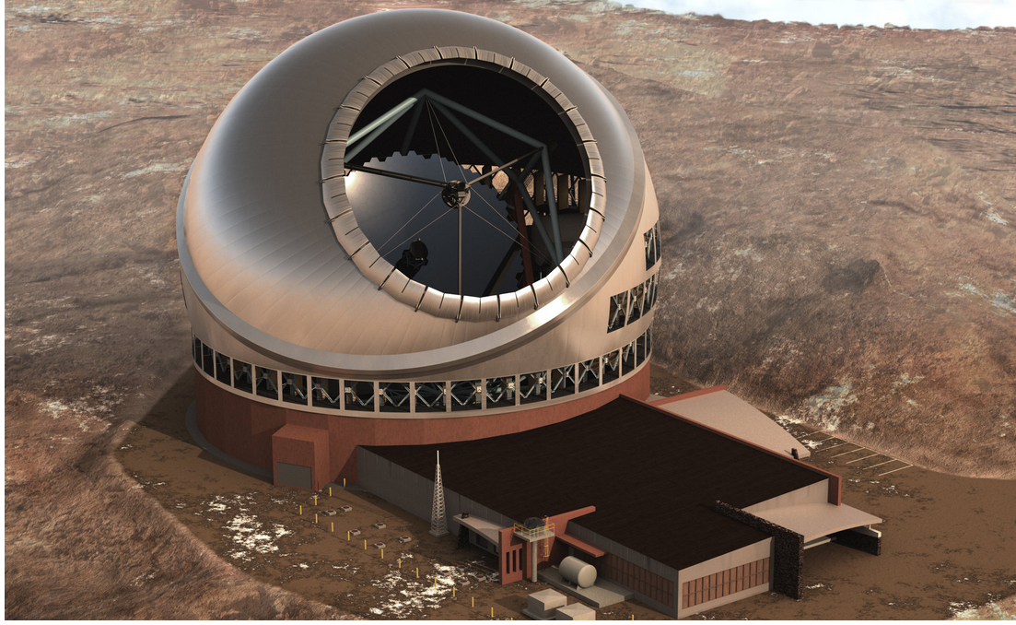
Mauna Kea Telescope
Artist’s rendition: NYT (July 27, 2017) : Giant Telescope Atop Hawaii’s Mauna Kea Should Be Approved, Judge Says, by Dennis Overbye

Slide 29
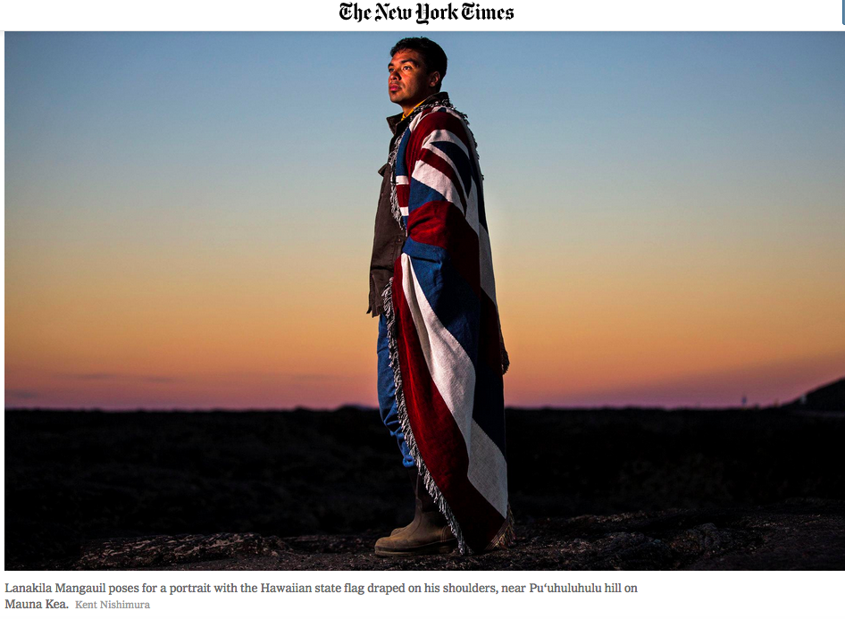

Slide 30
Pair Work
Decide with your partner who will work on creating an argument supporting the Mauna Kea telescope being built and who will oppose it.
Circle the claim (thesis) you are supporting:
The Mauna Kea telescope is important to science and should be built.
The Mauna Kea telescope will disturb the native Hawaiian’s sacred mountain and should not be built.

Slide 31
Mauna Kea Telescope
In class pair work and group poster work, using opposing viewpoint articles on Mauna Kea Controversy
Read through the two articles on Mauna Kea Telescope Construction Controversy:
https://www.nytimes.com/2016/10/04/science/hawaii-thirty-meter-telescope-mauna-kea.html
https://www.nytimes.com/2015/12/04/science/space/hawaii-court-rescinds-permit-to-build-thirty-meter-telescope.html

Slide 32
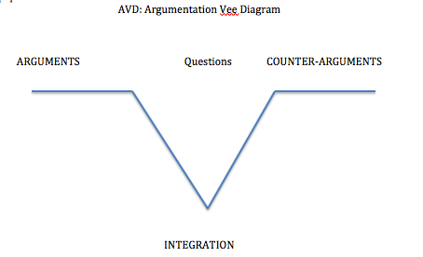
Dialectical Argumentation: Vee-diagram
Notes:
Sample questions:
On what evidence is this claim based?
Is this source reliable?
Is there a compromise solution?
Who benefits from this position?
What is the likelihood that is true?
Are there exceptions to consider?
What is a counter-argument to this claim?

Slide 33
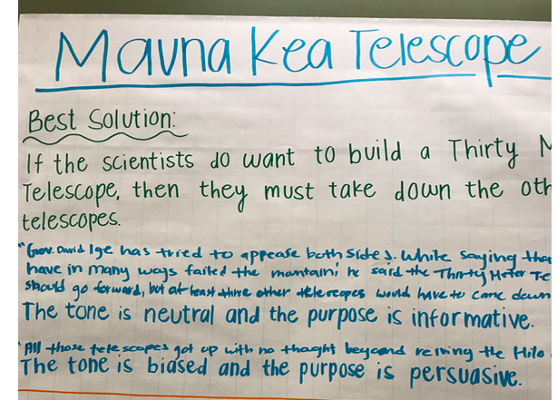
Finding the best solution

Slide 34
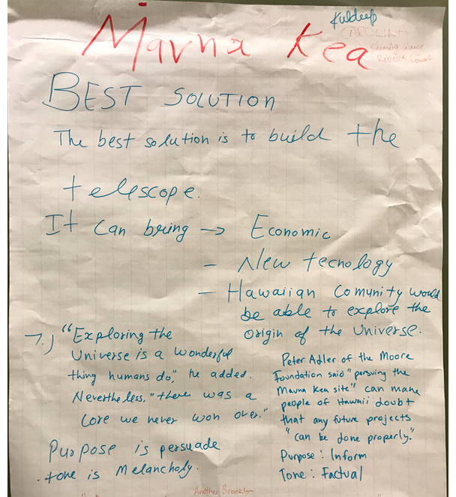
Another Student Poster

Slide 35
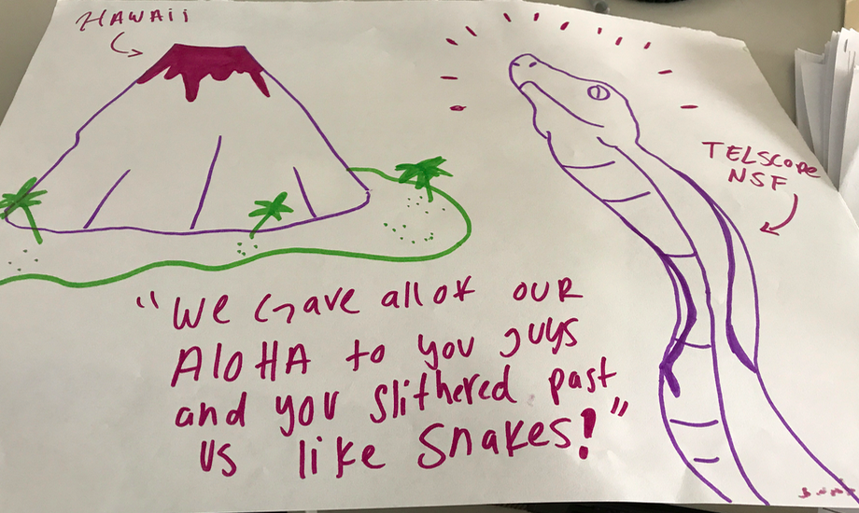
Visual Argument

Slide 36
Mauna Kea Follow-up
Court Cases
Arguments
Evidence
Visual evidence
Current Situation
Going Forward

Slide 37
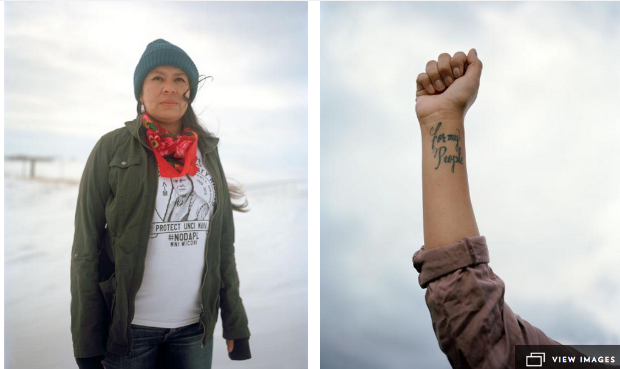
WawareWa

Slide 38
North Dakota Pipeline
Examination of various stakeholders
Company/government/native tribes/environmentalists/townspeople/rangers
Examination of purpose/tone/bias
Examination of evidence and sources

Slide 39
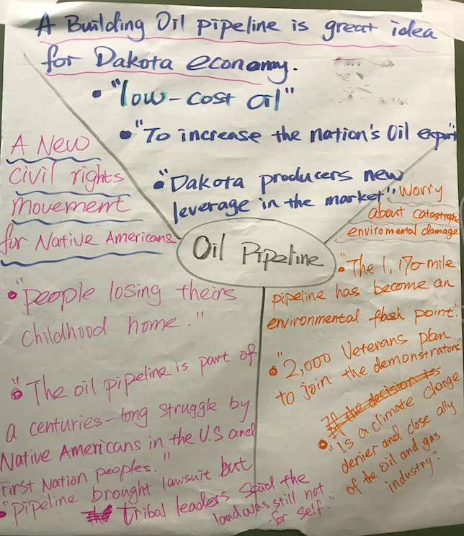
Stakeholders viewpoints with evidence

Slide 40
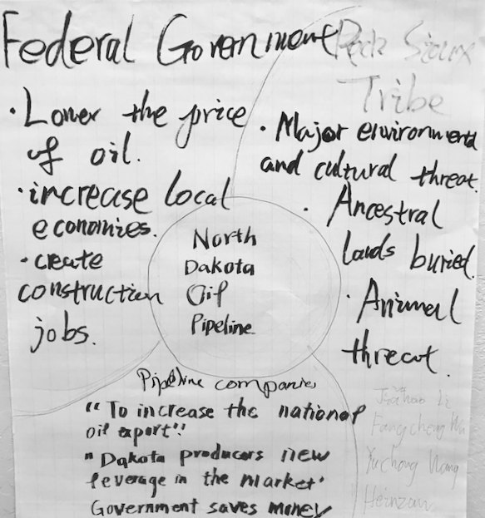
More Stakeholder Analysis

Slide 41
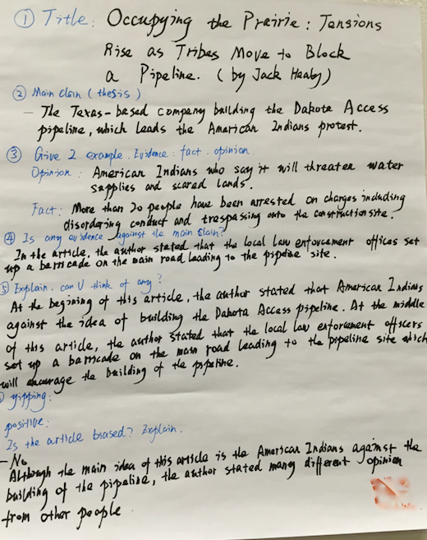
Argument Analysis

Slide 42
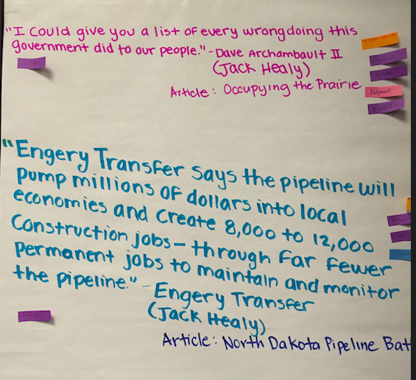
Quotation analysis

Slide 43
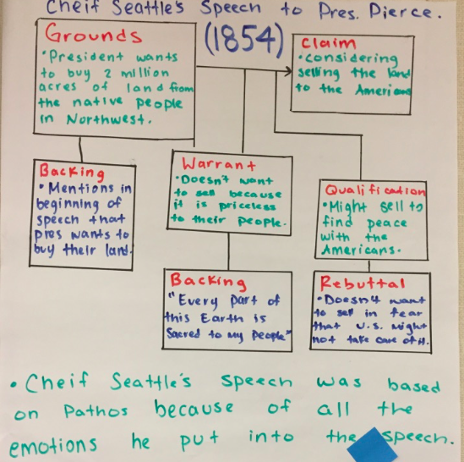
Cultural Views on Sustainability/Social Equity

Slide 44
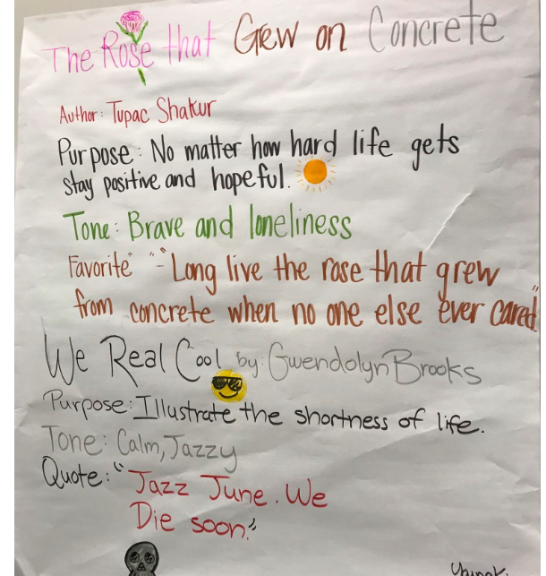
Sustainability Poetry/Social Equity

Slide 45
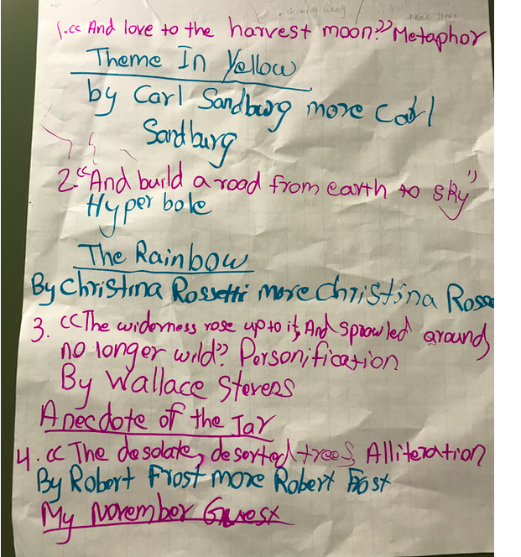
Environmental Poems: analyzed for attitudes toward environment

Slide 46
Uses of Place in Designing Research Paper on Sustainability and/or environmental theme
Example: Shellmound in Emeryville: Native Burial Site
Pro’s and Cons for construction
Any place can be researched so that the layers are pealed back
And human and geological histories revealed.
Great source for lesson plans on sustainability topic for classes:
A Primer for Teaching Environmental History, by Emily Wakild and MIchelle K. Berry

Slide 47
Bias, news, environmental conflict
TOPIC ONE
Write an essay in which you discuss how can one’s cultural identity influence one’s perception of events and perspective (both of participants and observers.) Is there still a “true” or best way of seeing events? Explain. Also decide if stereotyping and ”myside” bias can influence both how evidence is selected and presented by journalists and how we perceive it.
Use ideas and concepts from any two of the articles by Orwell, Velasquez-Manov, and Laub and also use examples form the North Dakota Conflict to illustrate the points you make on this topic. You may also bring in other current events to illustrate points but if you do this you must list them as a sources at the end of your paper.

Slide 48
Detecting Bias in News: Topic two
Given a particular event or issue in the news, (use Dakota Pipeline or another current issue see below for examples.) Describe how you would evaluate news to decide if it is fake or not and if not fake, is it reliable or possibly biased.
Use ideas and concepts from any two of the articles by Orwell, Velasquez-Manov, and Laub and also use examples from the North Dakota Conflict to illustrate the points you make on this topic. You may also bring in other current events to illustrate points but if you do this you must list them as sources at the end of your paper.

Slide 49
Environmental Research Paper
Topic One:Compare and contrast two-three views of nature presented in the readings. For example, you could compare a scientific view such as Lewis’ with a more spiritual or religious view such as Momaday’s or Erlich’s. Be sure to first describe the view, citing your source and then analyze how they diverge and overlap. Include a discussion of the potential implications of the view. Explain if you agree with each view and why. Use at least two of the readings from the textbook or handed out in class. You may also use other reliable sources and include your own views of nature as long as they are clearly articulated. Write 5-6 pages. Include a list of works cited at the end of your paper.

Slide 50
Topic Two
Describe two to three key (human-made) problems existing in our global environment. You may choose problems described in Scheid’s essay or other ones with which you are familiar, as long as you include information about it from a reliable source. Analyze how these problems were created, and critically evaluate the attitudes toward nature that they manifest. Then propose possible solutions to them, discussing whether each problem has a purely technological solution or whether a change in attitude toward the environment (and/or nature) is necessary. Explain. Use at least two readings from class and any other reliable sources you find. Include a works cited page at the end of your essay. Write 5-6 pages.

Slide 51
Whistleblowers: Flint Water Crisis
Examination of crisis
Analysis of timeline
Citizen Activism/Whistleblowers
Sustainable solution
Loss of trust
Court Cases

Slide 52
Whistleblower Information Literacy Course
Group Work Whistleblower Topics: (Mostly environmental!)
Karen Silkwood: Nuclear Power
Vandana Shiva: Indian farmer seed crisis
Marc Edwards: Flint Water Crisis
E. Snowden: NSA surveillance
LeeAnn Walters: Flint Water Crisis
Christopher Wylie: Cambridge Analytica
Manny Calonzo: Lead paint, etc.
(Philippines) misuse of data

Slide 53
More Whistleblowers
Destiny Watford: Baltimore incinerators
Lois Gibbs: Love Canal/pollution
Erin Brokovitch: Contamination
Jeffrey Wigand: Cigarette hazards
Majora Carter: illegal dumping/Bronx
Ramesh Agraawal: Mining (India)
Wangari Maathai (Africa; food insecurity/ Green Belt)
LaDonna Redmond: Food justice

Slide 54
Group Project
In your groups create a ppt: (Use google share ppt so link can be posted to discussion board)
1) Define the problem: why was this problem being hidden (or ignored), by whom, why?
2) Describe how the whistleblower became aware of the problem and gathered information/evidence about it.(provide concrete examples)
3) How did the whistleblower disseminate the information and to whom?
4) What were the results of the whistleblower’s action for the community?
5) Create short Bibliography: Cite at least one source from any library databases: e.g.

Slide 55
Reminder of SLOs
Identify the environmental, social, and economic dimensions of sustainability, either in general or in relation to a specific problem;
Analyze interactions between human activities and natural systems;
Describe key threats to environmental sustainability; and
Explain how individual and societal choices affect prospects for sustainability at the local, regional, and/or global levels.

Slide 56
Course Project
Analyze local sustainability related problem:
Eg: Ohlone Shellmound and developers in Emeryville
Coal in Oakland
Housing Crisis: Open Space, gentrification, congestion
Contaminated soil Bay Point
Police Bias Oakland
Look for evidence, stakeholders, sources, create argument

Slide 57
Sustainability and Teaching Practices
The [sustainability] crisis cannot be solved by the same kind of education that helped create the problems. David Orr
Use: inquiry based and experiential learning
Create internship/apprentice learning experiences
Use service learning opportunities
Engage student in research projects including faculty research
Use place: find spot on campus map, walk there, reflect on sustainable practice; look at place through layers of cultural, agricultural practice

Slide 58
Sustainability in Higher Education
(from AAISHE) Going beyond the academy
Curriculum
University
Operations
Research
Neighborhood
& Community

Slide 59
6 ways to change a course
Embed topic in curriculum
Add alternative readings
Create a new unit/course
Include applied research project
Guest speaker/team teach
Change course perspective or paradigm

Slide 60
Reflect, Pair and Share
Take a minute to think of and write down one or two ways you could change your course to include information on bias, perspective, and/or sustainability
Pair up and exchange ideas
Try to offer helpful suggestions
Speaker volunteers for group

