Slide 1
Fruitful collaborations: Building Bridges to connect student services
Hailley Fargo, MLIS (hmf14@psu.edu): Student Engagement Librarian, Penn State University Park
Emily Mross, MLIS (elm43@psu.edu): Business Librarian, Penn State Harrisburg

Slide 2
Outline
Introductions
University Park Collaborations: Search Bar
Penn State Harrisburg Collaboration: Write, Research, Revise
Tips for Success at Your Campus
Questions

Slide 3
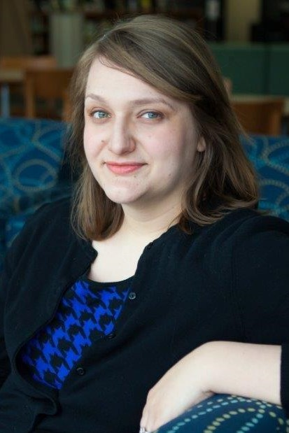
Emily Mross
Business Librarian at Penn State Harrisburg
Liaison to School of Business Administration and Library Marketing/Outreach Coordinator
In previous position at Northampton Community College, worked closely with Learning Center to provide collaborative/”Wrap-Around” services

Slide 4
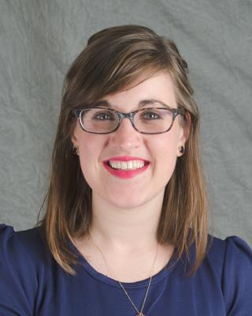
Hailley Fargo
Student Engagement Librarian, focus on student work in the libraries, Liaison to non-academic units, collaborations with Penn State librarians across the Commonwealth
Previous Evening Refence & Instruction Librarian at Penn State University Park
Experience with building collaborations across units along with background in Writing Center work

Slide 5

Search Bar
Suite of peer-to-peer services
Peer Research Consultants, Writing Tutors, and Tech Tutors

Slide 6
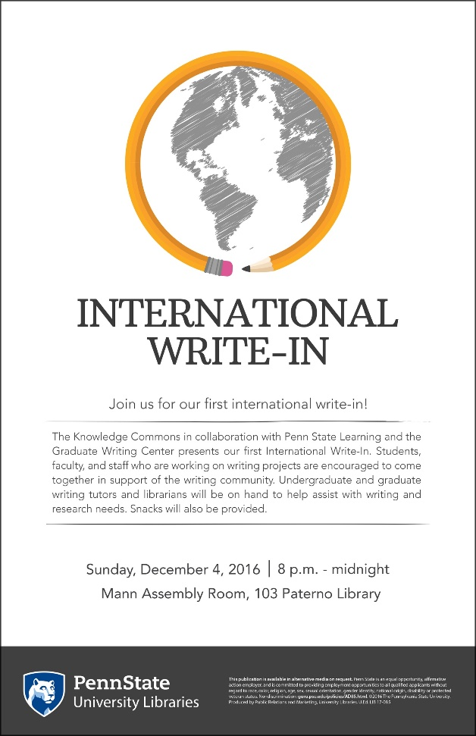
Fall 2016
Introductions made with goal of hosting Penn State's first International Write-In
Notes:
Initial introduction was made by my boss, and this began my relationship with the Writing Center.

Slide 7
At the same time...
Conversations happening in the Pattee & Paterno Libraries about our service model
Goal: Eliminate the "bouncing" patron
Goal: Increase exposure of Writing and Tech Tutors
Influenced by: Learning Commons/Knowledge Commons pedagogy, Peer-to-Peer research

Slide 8
Planning begins
Regular meetings with Writing Center representatives throughout summer 2017
Vision for integrative services
  Training + staff meetings
  Keeping track of student interactions
  Potential barriers to success (ex. Extension of hours)
Notes:
Hailley was in the middle of planning the PRC training, so having Karen around was super helpful in bouncing ideas off another writing center person

Slide 9
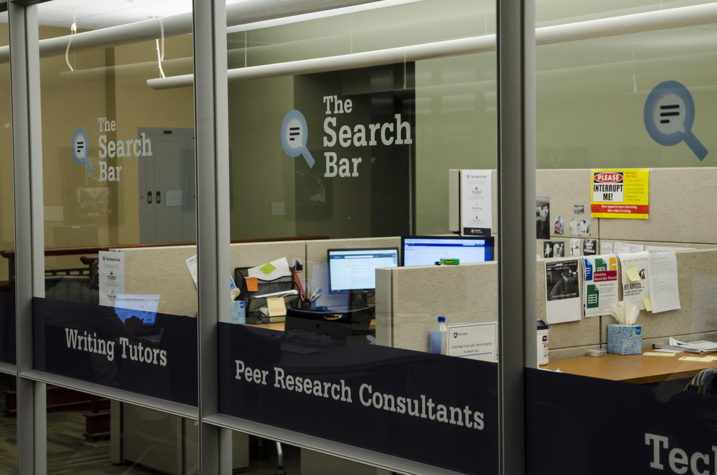
Opens September 2017
Notes:
Continued regular meetings with the Writing Center throughout the fall semester and other regular communication when things happened in the moment (someone didn't show up, old tradition happened such as leaving the final shift early)
Met in December for a debrief – honest about what we thought went well and where we could improve in the spring

Slide 10
Lessons Learned from Search Bar
Recognize that old traditions take time to adjust
Be open and honest with communication between stakeholders
Keep listening to the students who work in the space

Slide 11
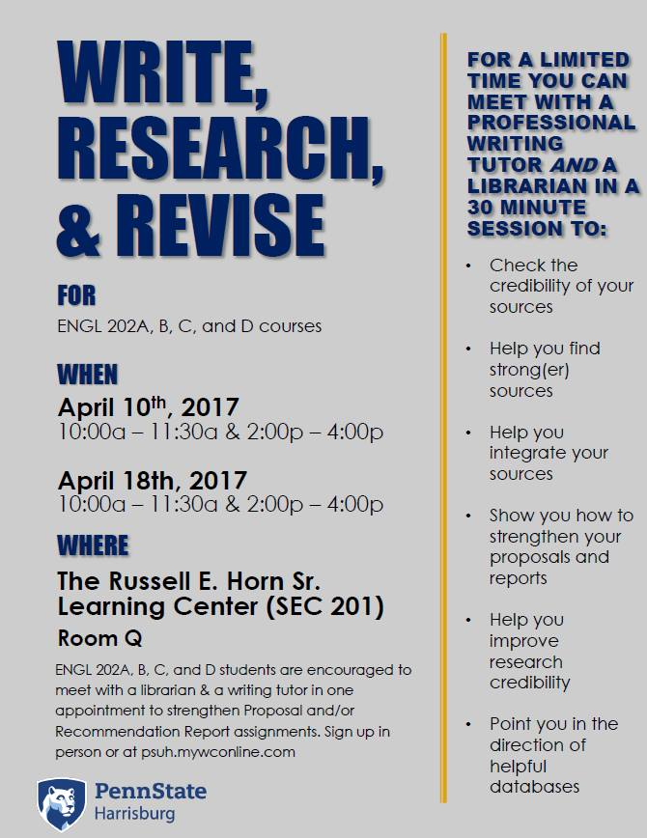
Write, Research, Revise
Targets students in required composition classes
30 minute collaborative appointments with a Librarian and a Writing Tutor
Students bring final paper draft
Leave with strategies/ideas for improving both writing and research to create a better paper

Slide 12
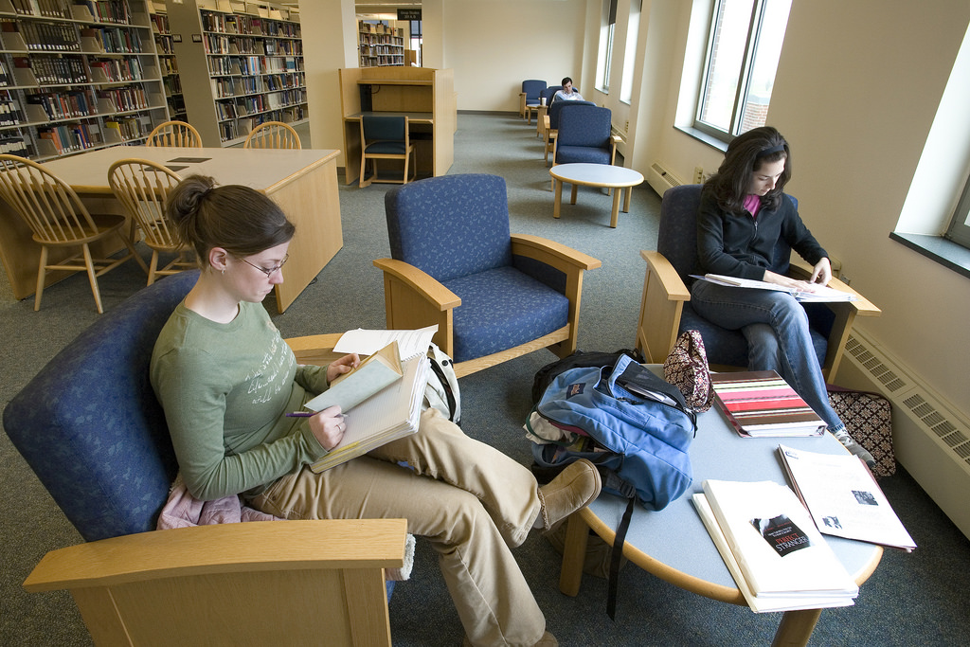
Previous Library/Learning Center Collaborations at Harrisburg
Due to space crunch, Learning Center Outposts were located in the library until Fall 2016
LC Director and previous Outreach Coordinator developed some collaborative projects for finals
Shared space made referrals easy

Slide 13
Getting Started with a New Collaboration
In 2016, the Library hired a new librarian and the Learning Center hired a Writing Coordinator
Learning Center opened in new Student Enrichment Center, ending co-location
Harrisburg undergraduate enrollment increases = more composition courses

Slide 14
WRR is born
Create event to maximize exposure and use of staff time
Provide additional assistance to students during high need time
Immediately prior to finals week when research papers are in progress
Combine both services in one location for scheduled appointments
Use learning center scheduling software and procedures
Capacity is limited to services provided by one librarian and one tutor

Slide 15
Targeted Courses
ENGL 015
ENGL 202
Required Freshman/First-year Composition Course
2016: Common syllabus; all students create a semester writing portfolio and final assignment is revising previous work
2017: No more common syllabus, but still research papers
Nearly all sections receive a library one-shot from the same librarian
First exposure to college research writing
Four versions (A, B, C, D) targeted at research writing in the disciplines
Should be taken at sophomore level, but often not
Nearly all sections receive a one shot from their subject librarian
Introduce discipline-specific research resources
Final assignment varies based on version from standard research papers to technical reports

Slide 16
WRR by the numbers
Fall 2016
Spring 2016
6 one-hour appointments
ENGL 015 students only
All appointments are filled in advance
32 half-hour appointments
ENGL 015 and ENGL 202 students
16 appointments per course
All appointments for ENGL 015 filled
3 appointments for ENGL 202 filled
Failed attempt at midterm appointments
Fall 2017
Offered 30 appointments
ENGL 015 students only
17 appointments filled

Slide 17
Outcomes
Successes
Challenges
All appointments offered for ENGL 015 were filled
Responses to post survey were all positive and encouraged offering WRR again
Positive anecdotal responses from course faculty
ENGL 015 students were prepared and engaged, made progress
Students followed up for additional help outside of program
ENGL 202 students were less engaged; were not prepared for appointments
Capacity limited by 2 person staff
Fall 2017: end of common ENGL 015 syllabus
Midterm appointments had no draw

Slide 18
Future Plans
We are working with faculty for ENGL 202 to develop incentives for participation
Develop a rubric for paper evaluation; compare participants and non-participants to assess impact
Adding additional librarians and writing tutors to increase capacity/times offered

Slide 19
Tips for Success At Your Campus
make introductions – New people? New spaces?
Build off any existing relationships – what worked before? Or not?
Gather existing data; keep track of new data
Brainstorm: What will your potential collaborations look like?
Keep open communication!
Keep revising!

Slide 20
Helpful References
Baer, A. (Andrea P. (2016). Information literacy and writing studies in conversation : reenvisioning library-writing program connections. Sacramento: Library Juice Press.
Del Bosque, D., & Chapman, K. (2007). Your place or mine? Face-to-face reference services across campus. New Library World, 108(5/6), 247–262. Retrieved from http://dx.doi.org/10.1108/03074800710748803
Estela Palomino, N., & Ferreira Gouveia, P. (2011). Righting the academic paper. New Library World, 112(3/4), 131–140. https://doi.org/10.1108/03074801111117032
Ferer, E. (2012). Working together: library and writing center collaboration. Reference Services Review, 40(4), 543–557. https://doi.org/10.1108/00907321211277350
Jackson, H. A. (2017). Collaborating for student success: An e-mail survey of U.S. libraries and writing centers. The Journal of Academic Librarianship, 43(4), 281–296. https://doi.org/10.1016/J.ACALIB.2017.04.005
Kuchi, T., Mullen, L. B., & Tama-Bartels, S. (2004). Librarians without Borders: Reaching Out to Students at a Campus Center. Reference & User Services Quarterly, 43, 310–317. https://doi.org/10.2307/20864243
Mahaffy, M. (2008). Exploring common ground: US Writing Center/Library Collaboration. New Library World, 109(3/4), 173–181. https://doi.org/10.1108/03074800810857621
Meyer, E., Forbes, C., & Bowers, J. (2010). The Research Center: Creating an Environment for Interactive Research Consultations - ProQuest. Reference Services Reivew, 38(1), 57–70. Retrieved from http://dx.doi.org/10.1108/00907321011020725

Slide 21
Questions?

