Slide 1
Open Access
Harvard University

Slide 2
Introductions
Harvard Library
Office for Scholarly Communication
Sue Kriegsman
Program Manager

Slide 3
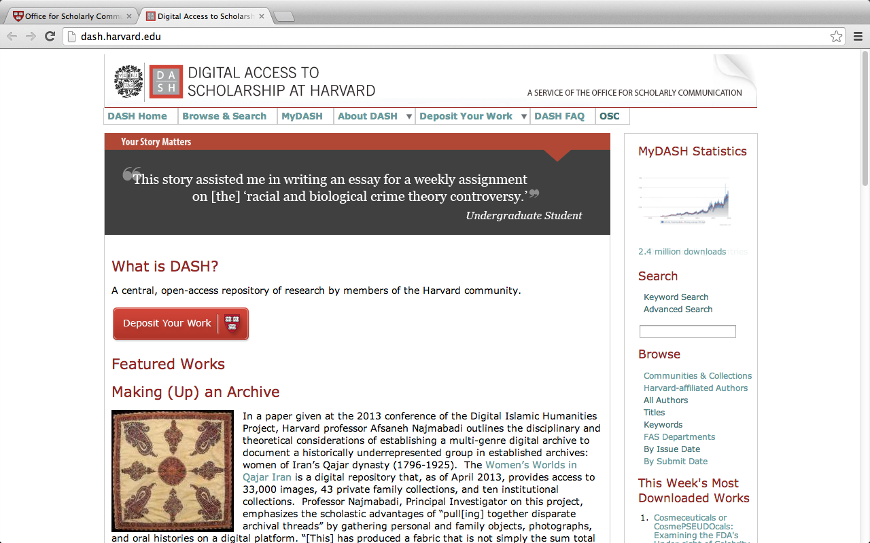
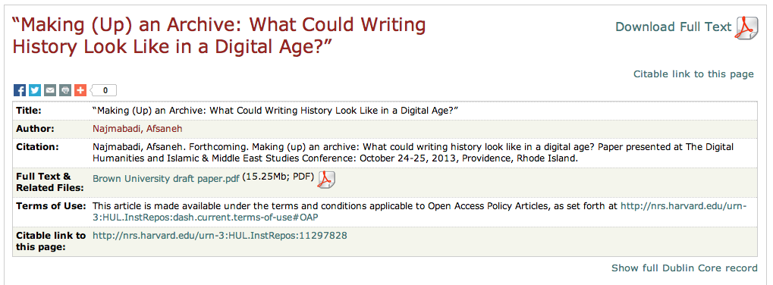
OSC
Office for Scholarly Communication
Spearheads campus-wide initiatives to open, share, and preserve scholarship.
DASH
Harvard’s open access repository: free, immediate, and open to all.

Slide 4

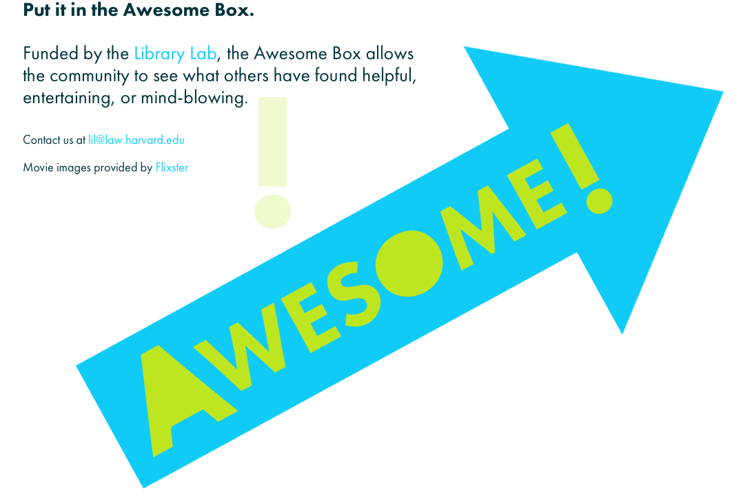



OSC
Peter Suber
Director of the OSC
Library Lab
Example: Awesome Box
HOPE funds
$32,236 awarded to 33 recipients since inception in 2009

Slide 5

Open Access
Open access (OA) literature is digital, online, free of charge, and free of most copyright and licensing restrictions.
The basic idea of OA is simple: make research literature available online without price barriers and without most permission barriers.
[It is] the academic custom to write research articles for impact rather than money… [OA] supports academic freedom and the kinds of serious inquiry that advance knowledge.

Slide 6








OSC
How did this start?
Concern about publishing model.
Movement among faculty.
Collaboration and cooperation.
Notes:
Does anyone have an OA policy at this time?
What discussions have come up around OA policies?
answering I share a dirty little secret about Harvard - we have 8 policies that were all voted on at different times and we are working on a 9th. Each school at Harvard operates independently and so a policy was passed for each individual school. So just when you think it might be hard at your school passing an OA policy just imagine doing it 8 more times.
Each discussion is different but they all need a champion, stakeholders, design, policy approval, implementation, education, outreach, education, outreach, rinse and repeat.

Slide 7

Open Access
Exposure
Audience
Rights Retention

Slide 8
Exposure

Slide 9
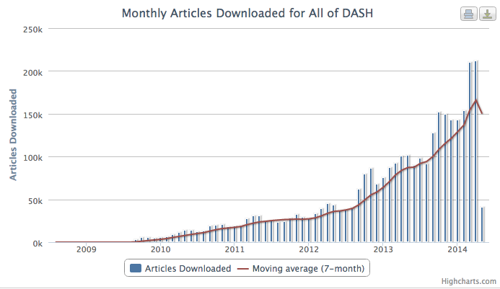
Exposure
Statistics don’t lie
…unless they are wrong.

Slide 10
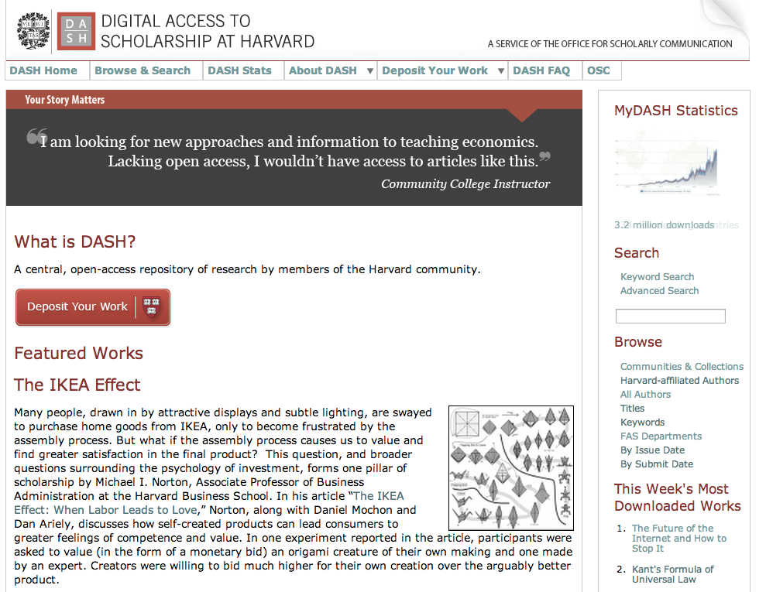
Exposure
DASH

Slide 11
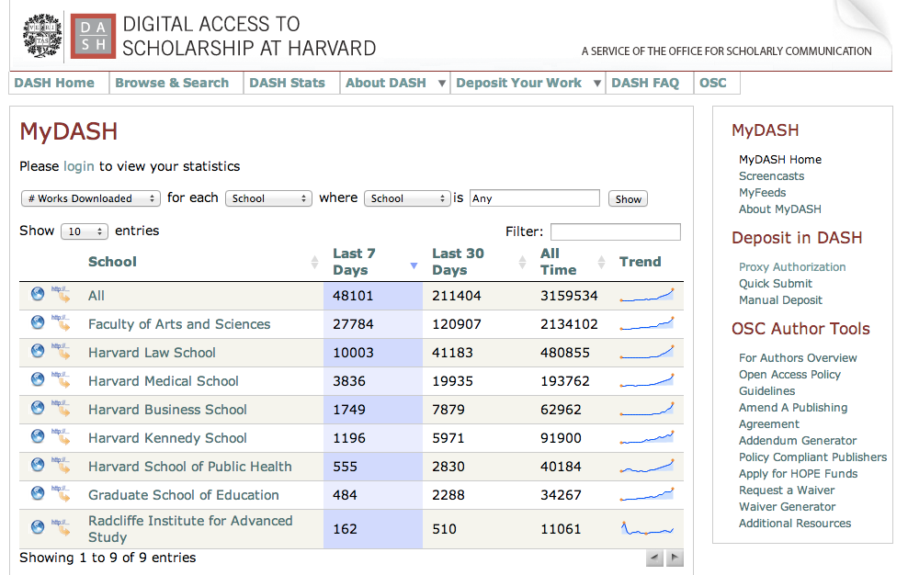
Exposure

Slide 12
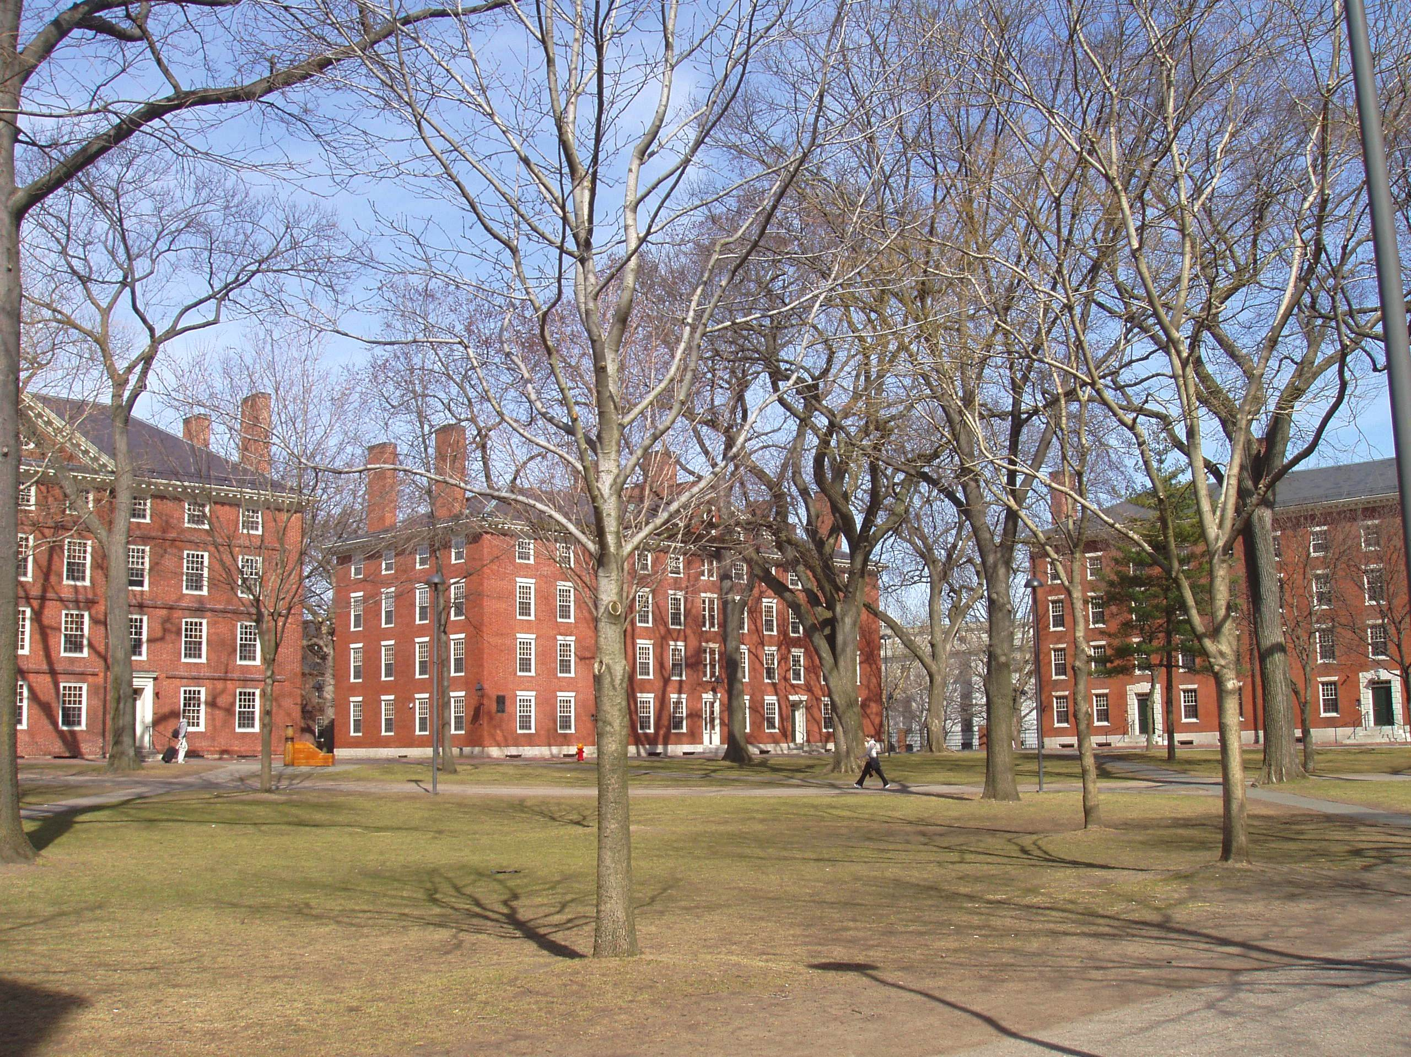
Exposure
November 2, 2012
“These figures are so bogus as to be unbelievable. What is the point of sending out statistics that are clearly unrealistic? There is absolutely no way that my one article in the DASH system (an article published in the late 1980s) is generating downloads 326 times by 103 users in 22 countries. It was of course a great article, my first!, but whatever methodology you are using to collect data on use of articles must be fundamentally flawed.”

Slide 13
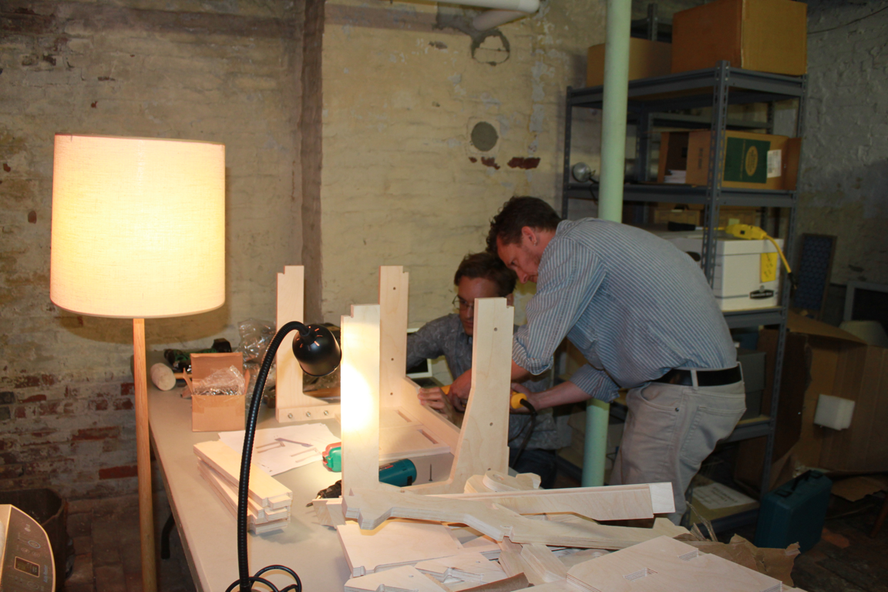
Exposure
Back to the drawing board

Slide 14
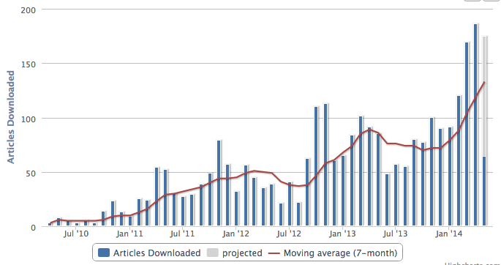
Exposure
Before
After
326 downloads
103 users
22 countries
146 downloads
103 users
22 countries

Slide 15
Exposure
One week later…
“Thanks very much for the time and effort you have taken to investigate and respond to my question. I still find it remarkable that one obscure article from 1985 generates such great interest! I will certainly set to work submitting more articles in order to feed my hungry fan base!”

Slide 16

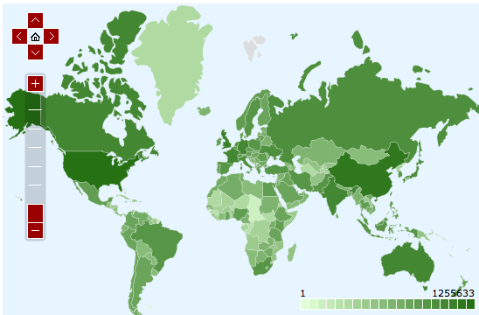
Exposure
April 2014
Notes:
2/3 from outside the U.S.

Slide 17
Audience

Slide 18
Audience
More readership
More citations
Impact and citation rates

Slide 19
Audience

Slide 20

Audience
Who is the audience?
Access to a single scholarly journal can cost as much as a car, every year.

Slide 21
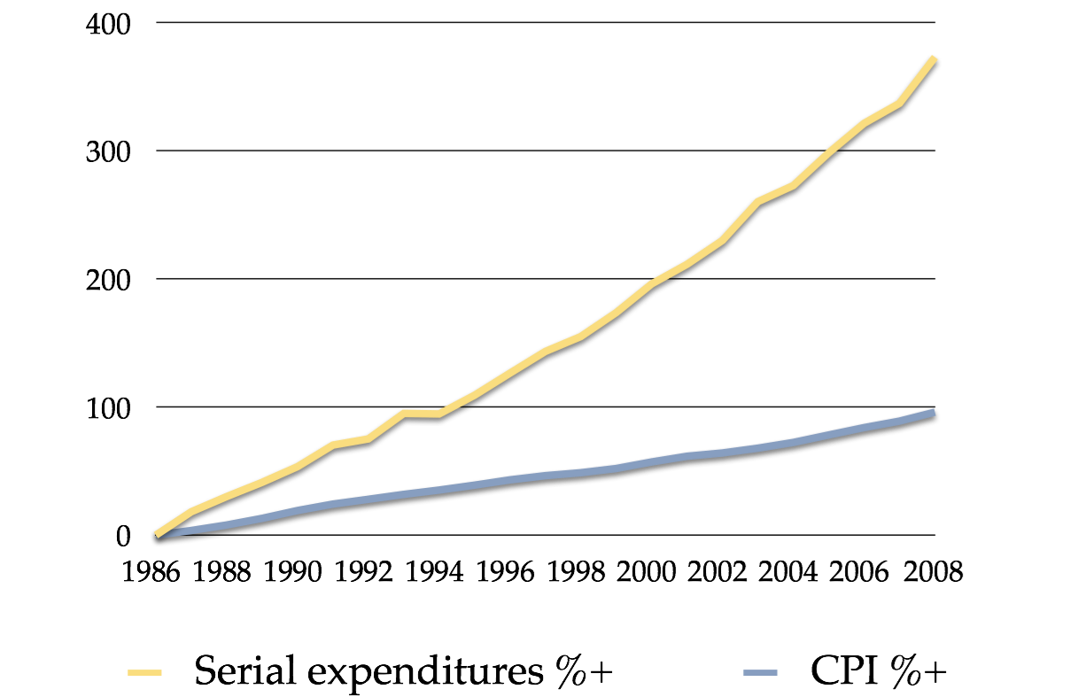
Audience
ARL Statistics 2005-06, 07,08

Slide 22
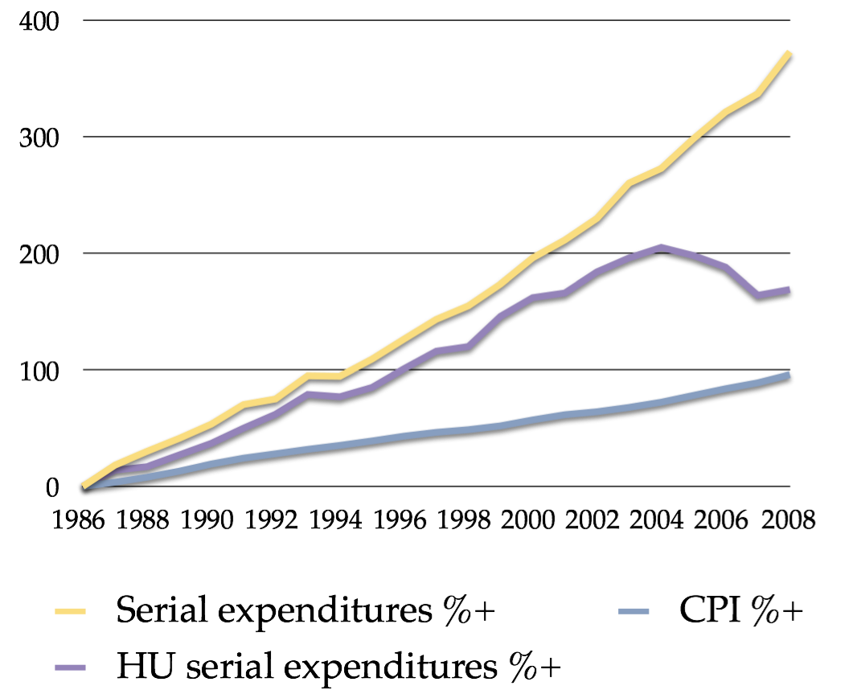
Audience
ARL Statistics 2005-06, 07,08

Slide 23
Audience
New readers
1/3 of all downloads from less-developed countries
Notes:
Mobile devices

Slide 24
Audience
Budgets
78% of academic libraries at African institutions have less than $100,000 per year to spend on journal subscriptions
Notes:
Mobile devices

Slide 25
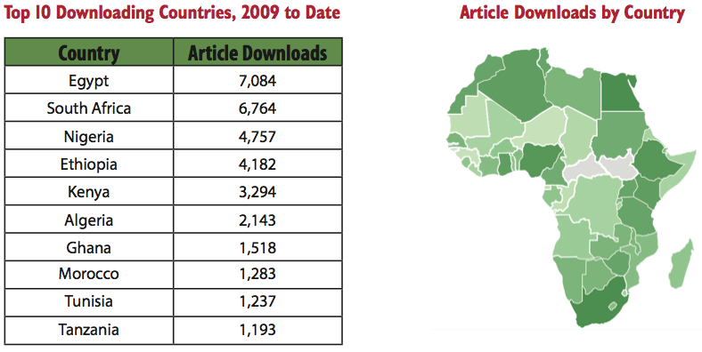
Audience
Top 10 Downloading African Countries
Notes:
Mobile devices

Slide 26
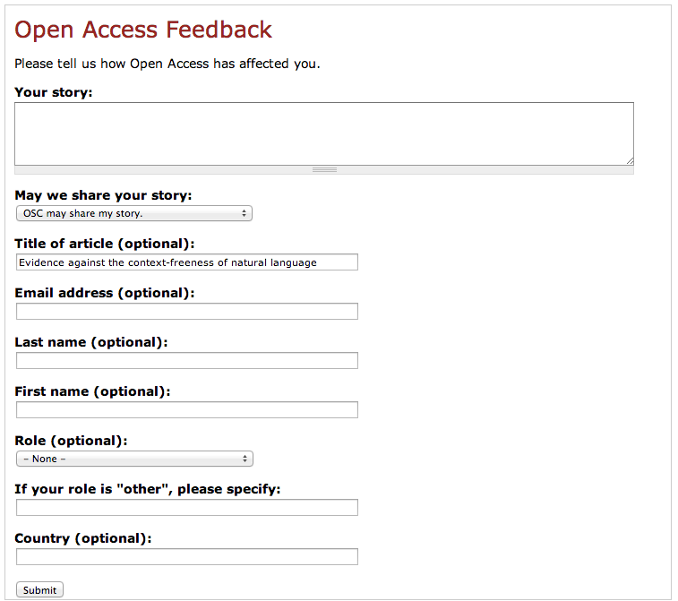
Audience
Readers with opinions
Notes:
Mobile devices

Slide 27
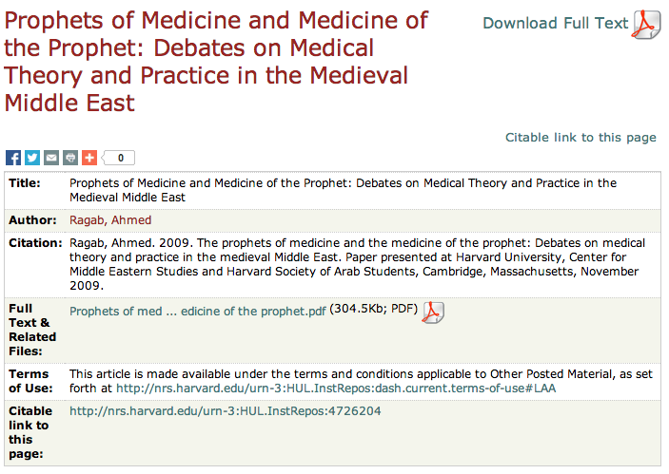
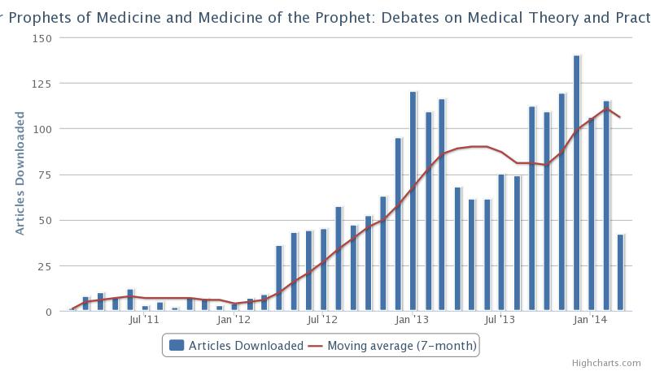
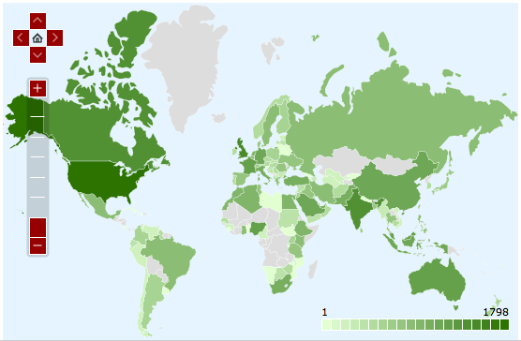
Audience
Student from US:
"[I am] writing a paper on prophetic medicine and using this in my intro as the background and the galenic medicine"

Slide 28
Rights Retention

Slide 29
Rights Retention
Permission
Waiver
Deposit
Notes:
OA Policy provisions

Slide 30
Rights Retention
Permission
Each Faculty member grants to the university permission to make available his or her scholarly articles and to exercise the copyright in those articles.
Notes:
OA Policy provisions

Slide 31
Rights Retention
The Dean or the Dean's designate will waive application of the policy for a particular article upon express direction by a Faculty member.
Waiver
Notes:
OA Policy provisions

Slide 32
Rights Retention
Each Faculty member will provide an electronic copy of the author’s ﬁnal version of each article no later than the date of its publication.
Deposit
Notes:
OA Policy provisions

Slide 33
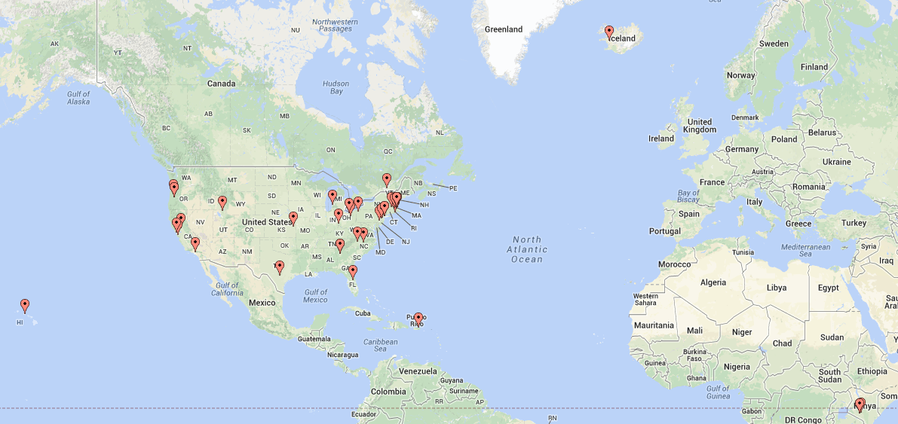
Harvard Faculty of Arts and Sciences, February 12, 2008
Harvard Law School, May 1, 2008
Stanford University School of Education, June 26, 2008
Harvard Kennedy School of Government, March 10, 2009
Massachusetts Institute of Technology (MIT), March 18, 2009
University of Kansas, April 30, 2009
University of Oregon, Library Faculty, May 7, 2009
University of Oregon, Department of Romance Languages, May 14, 2009
Harvard Graduate School of Education, June 1, 2009
Trinity University, October 27, 2009
Oberlin College, November 18, 2009
Wake Forest University, Library Faculty, February 1, 2010
Harvard Business School, February 12, 2010
Rollins College, February 25, 2010
Duke University, March 18, 2010
University of Puerto Rico Law School, March 24, 2010
Harvard Divinity School, November 15, 2010
The University of Hawaii-Manoa, Faculty Senate December 2010, Final adoption March 2012
Columbia University, Lamont-Doherty Earth Observatory, December 22, 2010
Strathmore University, c. February 2011
Emory University, March 15, 2011
Harvard Graduate School of Design, March 20, 2011
Columbia University Libraries, June 1, 2011
Princeton University, September 19, 2011
Rights Retention
Hope College, October 15, 2011
Bifröst University (in English), or in Icelandic, first vote May 2011; confirmed January 2012
Jomo Kenyatta University of Agriculture and Technology, c. March 2012
Utah State University, April 2012
Miami University of Ohio, Library faculty, May 14, 2012
University of California - San Francisco, May 21, 2012
University of Massachusetts Medical School, July 27, 2012
McGill University Librarians, c. October 2012.
Rutgers University, October 19, 2012
Harvard School of Public Health, November 26, 2012
Georgia Institute of Technology, November 27, 2012
Olin College of Engineering, November 28, 2012
University of Nairobi, December 2012
Wellesley College, February 6, 2013
College of Wooster, March 4, 2013
Amherst College, March 5, 2013
University of Rhode Island, March 21, 2013
Allegheny College, May 16, 2013
Stanford doctoral students at the Graduate School of Education, May 24, 2013
California Institute of Technology, June 10, 2013
Oregon State University, June 13, 2013
University of California, July 24, 2013
Bryn Mawr College, December 11, 2013

Slide 34
Rights Retention
Advantages of the policy
Makes a collective statement of principle.
Completely clarifies rights situation.
Allows university to facilitate article deposit process.
Allows university to negotiate collectively.
Opt-out versus opt-in increases rights retention.
Notes:
This policy has a number of nice effects. I’ve listed them roughly in their order of importance, by my lights.

Slide 35
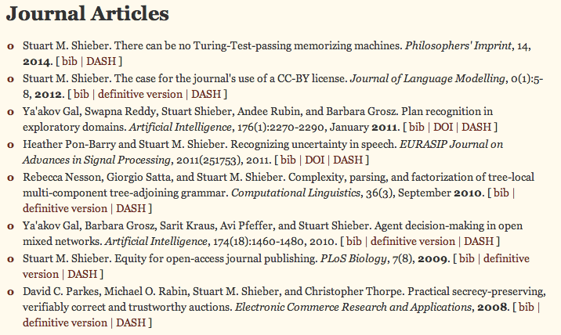
Rights Retention
Clarifies the rights situation
Web site
Copies to colleagues
Copies to students

Slide 36
Rights Retention
FAQ
What is in a policy?
What is covered under the policy?
  http://osc.hul.harvard.edu/dash/manuscript
What is the publisher reaction?
Should I always deposit my article?
What if my article is already posted and available?

Slide 37


Policy
Where to start?
Model policy
https://osc.hul.harvard.edu/modelpolicy
Good practices for university open-access policies
http://cyber.law.harvard.edu/hoap/Drafting_a_policy

Slide 38
Contact
Harvard Library
Office for Scholarly Communication
osc@harvard.edu
Sue Kriegsman
suzanne_kriegsman@harvard.edu
Harvard Library
Office for Scholarly Communication
osc@harvard.edu
Colin Lukens
colin_lukens@harvard.edu

