Slide 1
IF YOU BUILD IT,
THEY WILL COME
(IF YOU INVITE THEM THOUGHTFULLY)
Institutional Repositories in Academic Libraries

Slide 2
Part 1
Important Considerations

Slide 3
The ideal
Audience
Academic librarians
No current digital repository in place
Curious about how to get started

Slide 4

The rest of you
Homer Sleeping. (May 5, 1994). 20th Century Fox. The Simpsons, season 5, episode 20, “The Boy Who Knew Too Much.” Retrieved on May 28, 2014 from http://blabsta.com/10643

Slide 5
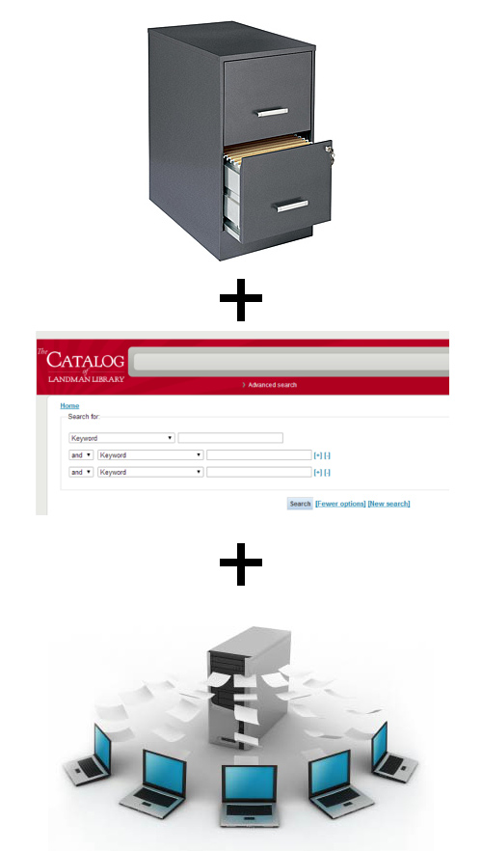
Basics
Online, indexed resource for digital, (often) institutionally-produced content.
Content can be:
  text documents
  images
  video
  audio
  raw data (tables, etc.)
Usually (though not necessarily) accessible and open to the public.
  Files are downloadable.
  Records are indexed by public search engines (like Google).

Slide 6
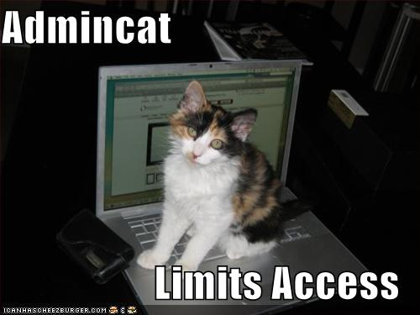
Consider:
Platform Source
Open Access
On-Hand Tech Skill
zebedee.zebedee. (2008) funny-pictures-cat-limits-your-computer-access. [photograph] Retrieved from https://flic.kr/p/5woeRj
Notes:
Platform Source
What is the basic coding language/protocol from which the repository software is built?
Answers have both ethical and practical implications.
Ethical: whether the library will or won’t be contributing to the communal knowledge and development of resource.
Practical: amount of library staff familiarity with the basic language/operation of the product.
• Open Access
Will it be accessible to the public, and will the contents be freely downloadable?
Most DRs operate under open access parameters.
Natural that the guiding principles of the repository reflect the practices of the libraries maintaining them.
• Technical Skills Needed to Configure/Manage
How much programming skill is required to operate the software at an optimal level?
The need for on-site staff with technical/IT skill will vary depending on the DR platform.

Slide 7

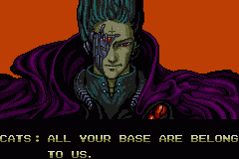
Consider:
User Base
File Formats
Metadata
Aybabtu.png. (n.d.). In Wikipedia. Retrieved May 28, 2014 from http://upload.wikimedia.org/wikipedia/en/0/03/Aybabtu.png
Notes:
• Established User Base
Does the repository have a large, established user base?
The larger the established user base, the greater the chance that someone will have encountered and addressed a particular technical problem.
• Accepted File Formats
What are the file formats supported by the platform?
It’s important to decide what standards will be followed in digitizing and storing files in the DR, and also to ensure that the potential platform works with those formats.
• Metadata Standards
Does the platform structure its records around a particular metadata standard?
Having a base for records that is built using one of the common metadata standards is a good idea, especially in cases where data migration becomes necessary.

Slide 8

Consider:
Add’l Files
File Embargoes
Email / RSS
Ramon Allones 898 cigars from Cuba – 20051019. (October 19, 2005). On Wikipedia. Retrieved from http://commons.wikimedia.org/wiki/File:Ramon_Allones_898_cigars_from_Cuba_-_20051019.jpg
Notes:
• Supplemental Files
Can supplemental files be added to item records?
Occasionally, there are additional files that are relevant to an item in a repository, be they data sets, earlier drafts, spreadsheets, etc.
• Embargo Management
Does the platform have built-in support for publication embargoes imposed by third-party publishers?
Some DR platforms allow items to be submitting, uploaded, and indexed, all while applying an embargo period to the record, which prevents the full-text of the article from being accessed until a certain span of time has elapsed.
• Email and RSS Outputs
Can the platform export records, or links to records, via email? Is there an option for users to subscribe to RSS feeds for collections?
An important component of research and discovery is the user’s capacity to share their information with others.

Slide 9
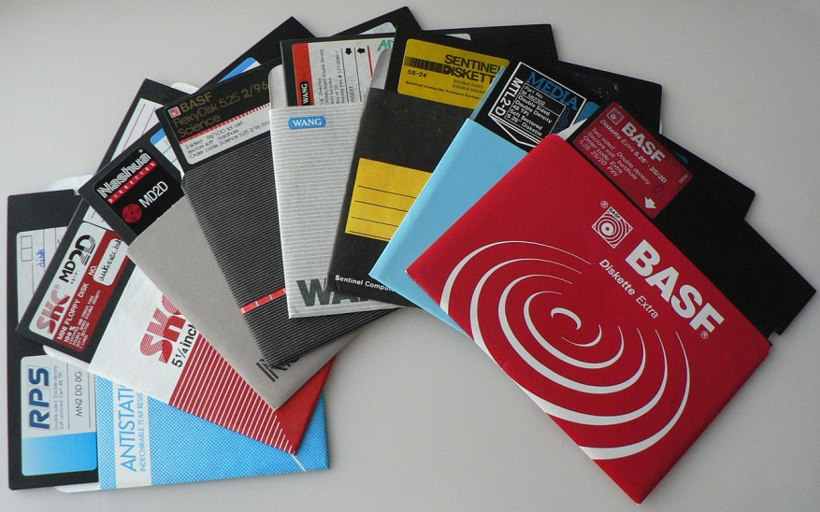
Consider:
Profile Pages
User Depositing
Space / Capacity
5Waaier 5¼-inch diskettes. (n.d.). On Wikipedia. Retrieved May 28, 2014 from http://commons.wikimedia.org/wiki/File:Waaier_5%C2%BC-inch_diskettes.JPG
Notes:
• Researcher Profile Pages
Does the platform allow for contributors and researchers to create or maintain a profile page?
Profile pages seem to present a major allure to faculty, who can create a virtual CV, linking directly to their online publications in a way that a printed copy never could.
• Direct Depositing by Users
Can users submit work themselves via a page or form on the repository site?
A user-controlled submission process can free up staff time that would otherwise be spent negotiating a submission—possibly through email—and manually uploading it to the repository.
• Size of Hosted Space
How much server space is allocated for the repository contents? Is this expandable, should the repository grow? Is there a cost associated with expansion?
Knowing the limits of that available space is important, especially for a collection that comprises any amount of non-print material.

Slide 10

Consider:
Annual Cost
Set-Up Fee
Consortium Option
Monopoly Guy. (n.d.). Warner Bros. Monopoly Board Game. Retrieved on May 28, 2014 from
http://chronicle.com/blognetwork/tenuredradical/2014/02/dear-mr-kristoff-a-letter-from-a-public-intellectual
Notes:
• Annual Hosted Cost
What are the annual hosting fees associated with the platform?
A basic issue: the schedule of fees associated with the particular vendor and platform.
• Set-Up Fee
Is there a fee for setting up the repository that is separate from the annual hosting fee?
Occasionally, a vendor charges a fee for the initial creation and arrangement of the repository.
• Consortium Options
Are there pricing options for consortia?
Collective membership can work to the benefit of all involved, if the vendor is able to negotiate for it.

Slide 11
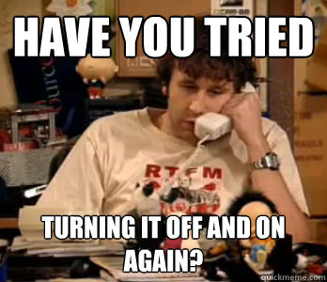
Consider:
Usage Stats
Tech Support
Digital Publishing
Roy. (February 3, 2006). BBC. The IT Crowd, series 1, episode 1, “Yesterday’s Jam.” Retrieved on May 28, 2014 from
http://www.quickmeme.com/img/44/4463d682735d1cb300ce7e5032c9128e3dd4a553f5a2fc44273e07f8a3ae07bd.jpg
Notes:
• Usage Statistics
What kind of usage statistics does the vendor utilize for the DR?
It is very important that administrators of the repository be able to access and generate detailed reports on the DR’s web traffic and downloads.
• Tech Support
Is there any limit to the amount of tech support that the vendor provides? Is the tech support plan a “tiered” one?
Occasionally, there will be limits—usually based on quantity of time or help tickets—to the support offered from a vendor, with additional amounts of support offered for additional fees.
• Digital Publishing
Does the platform offer workflows for digital publishing?
Digital publications might require that external editors get access to submission queues, be able to display and promote new content from the collection, and negotiate other functions common in publishing.

Slide 12

Consider:
Disaster Recovery
Discovery Tools
Authentication
The Moment. (November 23, 2013). BBC. Doctor Who, “The Day of the Doctor.” Retrieved on May 28, 2014 from
http://www.fanpop.com/clubs/doctor-who/images/36045867/title/day-doctor-preview-imagethe-doctor-moment-photo
Notes:
• Disaster Recovery Plans
What is the disaster recovery plan that the vendor has in place?
Any DR vendor should have details on a plan for disaster recovery that they can share with potential clients. Aspects of the plan to look for include off-site backup servers specs and periodicity of server backups.
• Discovery Tool Compatibility
Is the DR compatible with all major discovery tools?
It is useful to know if the potential platform is able to communicate with the local OPAC, electronic resources, as well as search the indexed contents of the repository.
• Authentication System Compatibility
Is the DR compatible with any campus authentication system?
Though the driving ethic behind most repositories is one of open access, the platform must still be able to negotiate communication with an existing authentication or proxy system.

Slide 13

Consider:
IT Department Certified
Rabbit of Approval. (n.d.). Annie’s Homegrown, Inc. Retrieved on May 28, 2014 from http://www.joshilynjackson.com/ftk/?p=754
Notes:
• IT Staff Acceptance
Has your institution’s IT staff examined the specifications of the platform? Do they believe that the product will integrate smoothly with existing campus systems?
IT staff will have the perspective and technical understanding to give a general assessment of any platform that you are considering.

Slide 14


Additional steps:
Quantified Scale Rating System
NC-17 Preview. (1990). Motion Picture Assoc. of America. Retrieved on May 28, 2014 from http://www.rantlifestyle.com/2014/03/06/20-popular-nc-17-movies-time/
Notes:
Quantitative Scoring
Ease of use: 1= Bad design; no browsing; no branding / 2= Minimal design; minimal browsing; minimal logo branding / 3= Decent design; 3+ browsing options; acceptable branding / 4= Good design; 4+ browsing options; profiles; advanced search options/ 5= Fantastic design & branding; lots of options, exports, alerts; social media interaction
Degree of Customization: 1= No customization / 2= Minimal customization / 3= Adequate customization / 4= Good customization; choice of free or fixed vocab, but not both / 5= Thorough customization, including metadata; free and fixed options for vocab
Cost: 1= $30,000+ / 2= $20-30,000 / 3= $15-20,000 / 4= $10-15,000 / 5= <$10,000
Support: 1= 20 hours / 2= 40 hours / 3= 80 hours / 4= 160 hours / 5= Unlimited

Slide 15
THANK YOU!
Questions?
Me:
Eric Jeitner
User Experience Librarian
Richard Stockton College of NJ
eric.jeitner@stockton.edu

