Slide 1
Undergraduate Research Behavior:
Do we really want to know what they’re doing out there?
Bonnie Imler, Library Director, Penn State Altoona
Michelle Eichelberger, Systems Librarian, Genesee Community College

Slide 2
“Our stuff is hard to use and not very simple to navigate for answers or resources.”
Michael Stephens, “Office Hours” Library Journal
June 15, 2011
Summary of student comments from Future of Academic Libraries Symposium presented by McMaster University & Library Journal
Notes:
MAE slide
This idea underlies all of our research.
We have to work hard to convince students to use our resources because they're not easy to use like Google.
From interactions with students at the reference desk, we suspect that students aren't using our resources, or aren't using them correctly, and it's hard to blame them
How could we find out if our suspicions were correct?

Slide 3
Is what we see at the Reference Desk…
representative of the population or just a fluke? Does everyone else understand how to use the library resources? Or do they just not try?
students who have or have not received previous instruction from a librarian?
students who have struggled over our databases for hours or mere minutes?
Notes:
BBI: We make attempts to teach students how to use library resources, but disconnect between the classroom and what we see at the desk, or what those who aren’t coming to the desk are doing.
Examples:
(1.) If a student appears to pass over perfectly good articles that are only available through SFX for others with obvious links to full-text…
Do they just think the articles lack potential?
Do they think the full-text of the article is unavailable?
Are they unaware of SFX and it’s potential?
Have they ever received instruction on using SFX?
If they are aware of SFX, are they just unwilling to make one or two more mouse clicks to obtain the article?
(2.)If you find a pile of printed abstracts abandoned next to the printer…
Did the instructor request abstracts and the student printed them but forgot to pick them up?
Did the student think they were printing the full-text of the article and abandoned the abstracts in disappointment?

Slide 4
Our Questions
How can we figure out what the students are really doing out there?
Are they really as confused as we think they are?
Are the databases as clunky and complicated as we think they are?
Are they comprehending and retaining anything we are teaching them?
How can we observe them without being obvious and without changing our results?
Notes:
MAE slide
These are huge questions and could take us years to research. We decided to focus on the first and last questions, and hoped that we'd get some insight into the middle ones.

Slide 5
Screen Capture Technology
Advantages:
Inexpensive – many already own it for instructional videos
Does not require the observer to be in the room with the participant
Captures all mouse movements, clicks and typing
Movie can be reviewed many times
Movie can be coded for common criteria
Notes:
BBI. [talk about your "aha" moment at Studiocode seminar] Screen Capture Technology allows you to be a fly on the wall and answer the question “How are they searching these databases?”

Slide 6
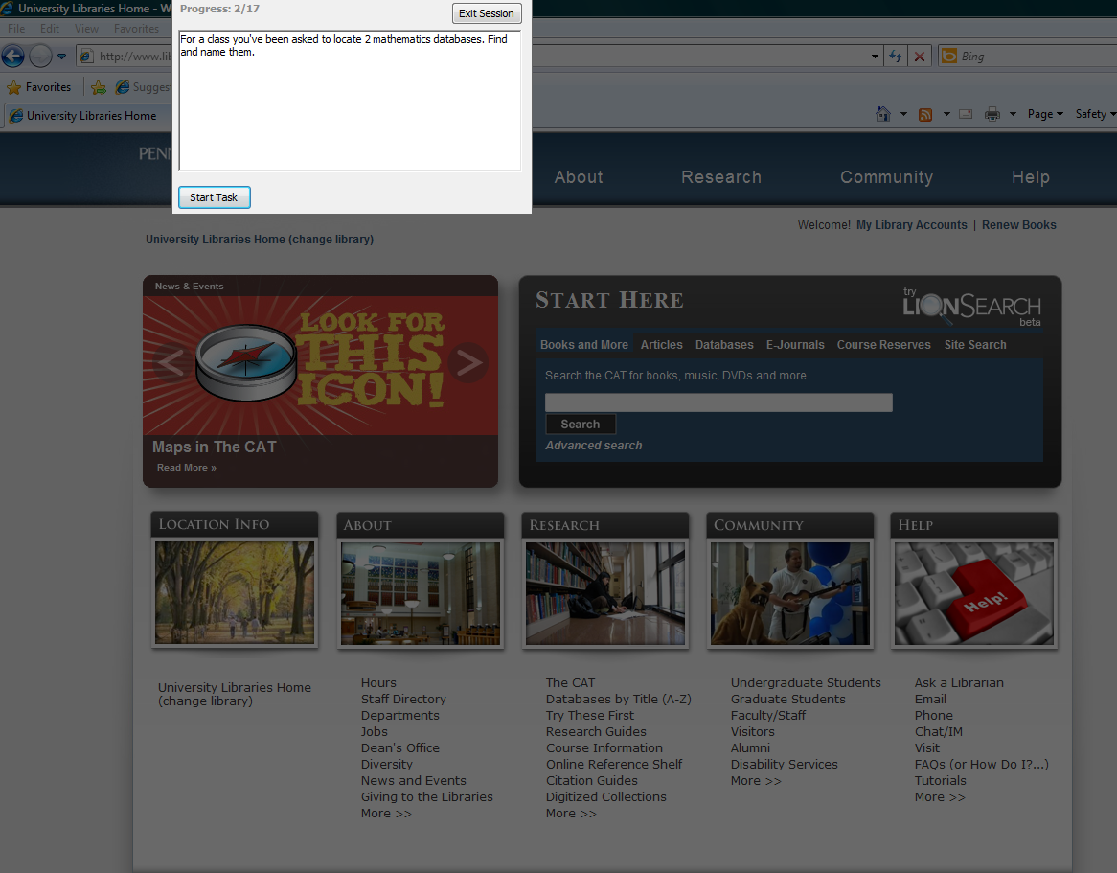
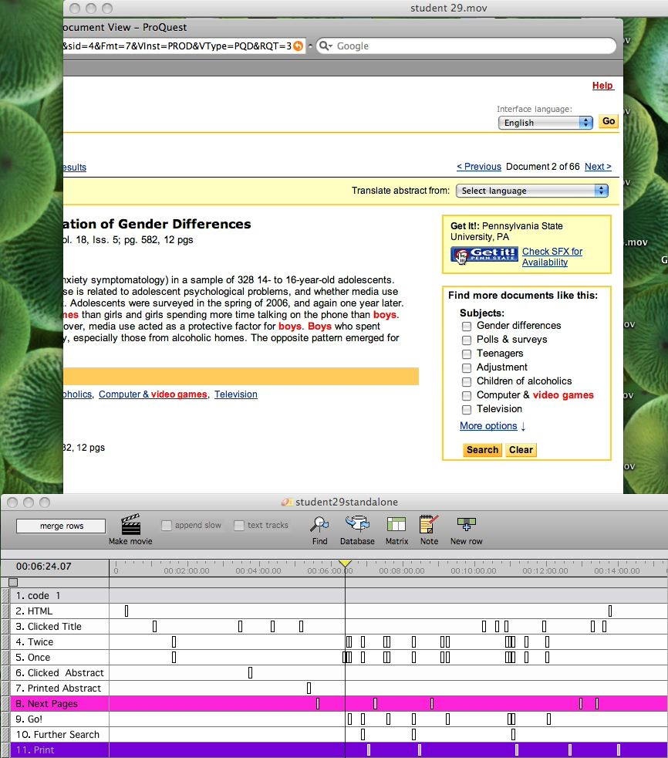
Screen Capture Choices
Free
Jing (Free Copy)
Notebook/Pencil
$
SnapzPro
StudioCode
$$
Techsmith Morae
Notes:
BBI slide

Slide 7
Research Interest:
Article Retrieval
Heavily used by undergraduates
Often the best source for current information but hard to use
No standard format across vendors– each with its own interface and quirks
Complications: SFX, Interlibrary Loan options
Why?
Notes:
MAE slide. Had the technology, now had to focus our research. Picked something that's a persistent problem, chronic questions at the reference desk. The databases are not as easy to use as we'd like them to be. Often the best sources of information.

Slide 8
Research Design
Project 1: SFX
Students all received same in-class instruction
Recruited at least 2 weeks after the initial class
Given canned ProQuest search
Instructed to select and print 5 entire articles for a research paper
Notes:
MAE slide
Project 1:
wanted to start with a contained group,
wanted to know that all students had had instruction & been exposed to database searching & sfx, decrease variation
Waited to recruit so that instruction wasn't fresh in mind, wanted native searching behavior
Canned search so that would be working with same results, didn't want them to deal with typos, variety of terms, time it would take to enter search, etc.
Select and print so that we could tell if they were finding full-text or abstract, printing as indication of choice

Slide 9

Printing as an Indicator of Choice
Print to a non-existing printer and disable any error messages.
Notes:
MAE slide: Students will pause on many articles before actually selecting one. Printing shows their ultimate choice.
We did not want to waste paper on articles that wouldn’t be read and didn’t want students wasting time waiting for it to print out. In both cases they were verbally instructed that the printer was outside of the room and they could move on to the next article as soon as they pressed PRINT.
IT people love it when you call and ask them if they can set the computer up to a printer that doesn’t print.

Slide 10
Abstract/Full Text Printing in Project 1

Slide 11
Research Design
Project 2: Abstract vs. Full Text
Recruited first year students – no previous instruction
Given 5 separate URL links directly to articles
Instructed to print entire article
Asked to define terms abstract, full-text, and pdf at end
Notes:
BBI slide
One study can lead into another…Study 2 Focused solely on students locating the full text in 5 databases. Used many of the same articles/databases that confused the first research subjects.

Slide 12
Abstract/Full Text Printing in Project 2

Slide 13
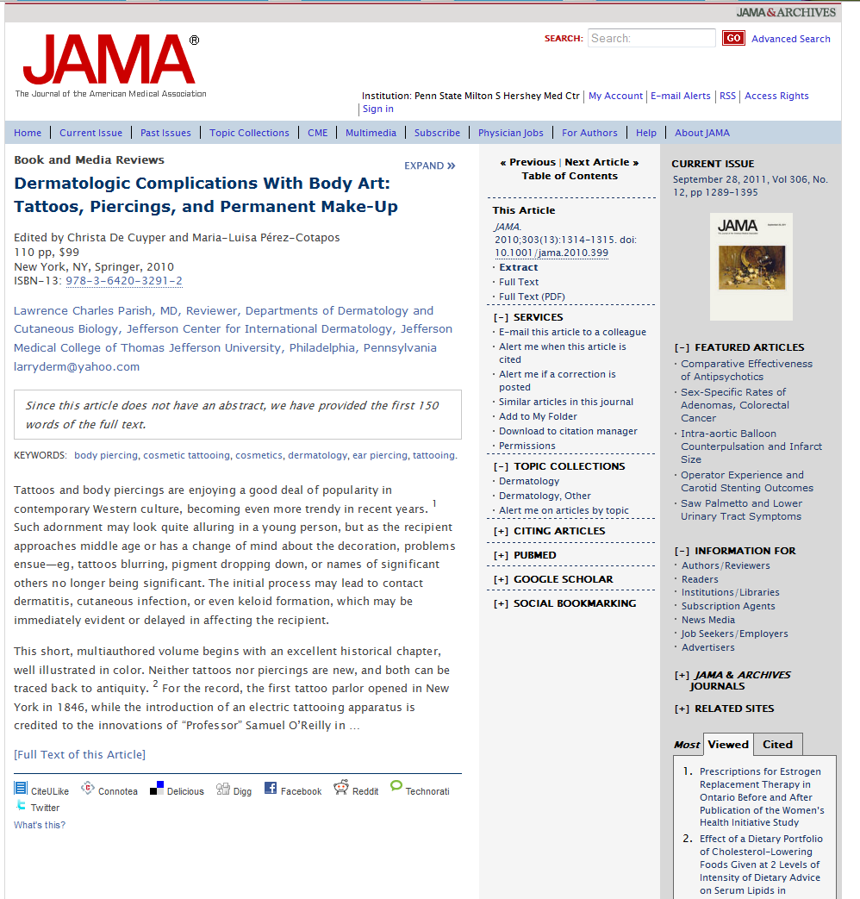
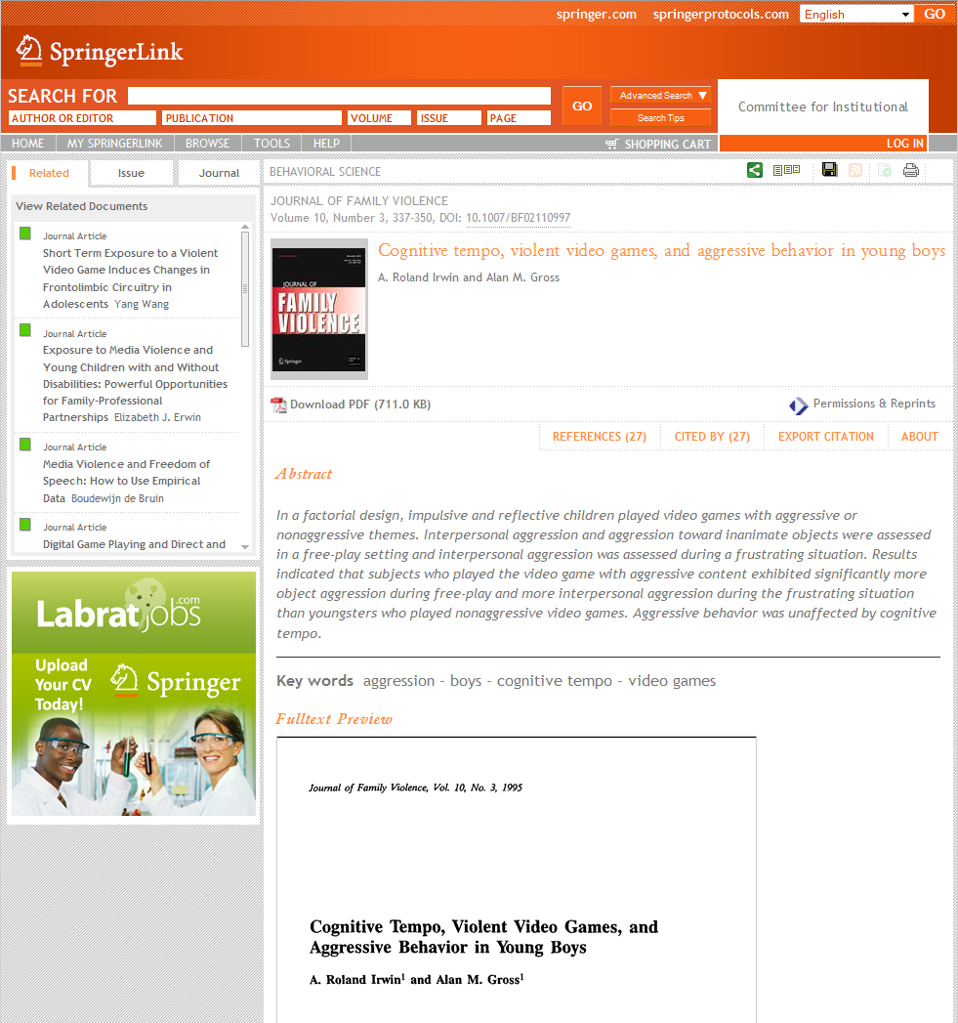
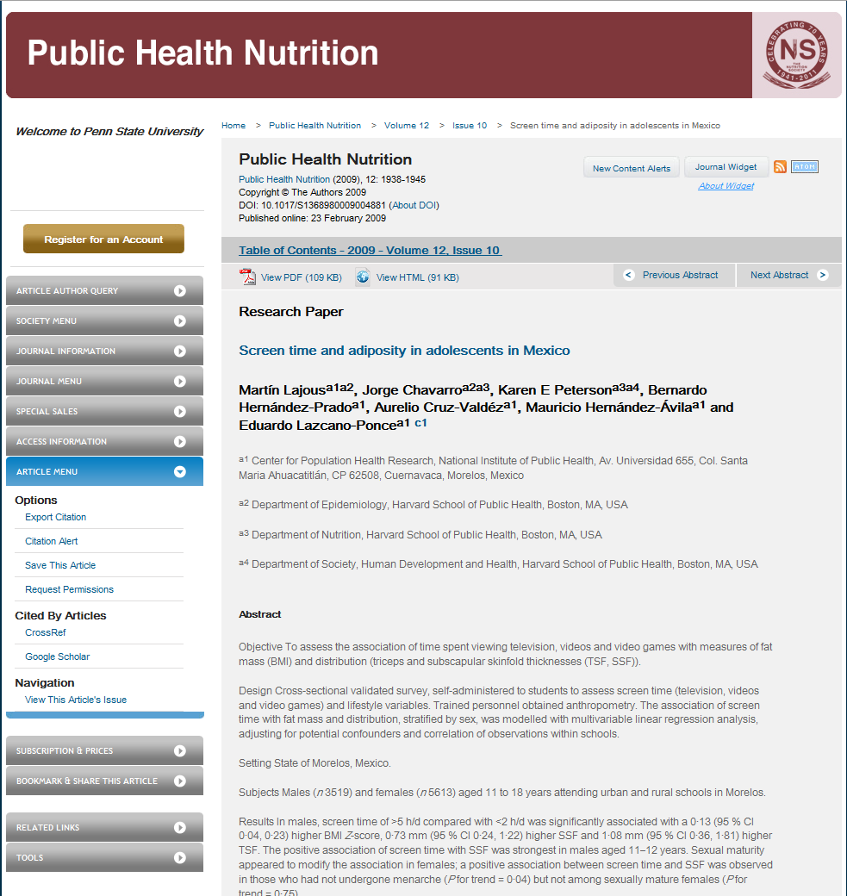
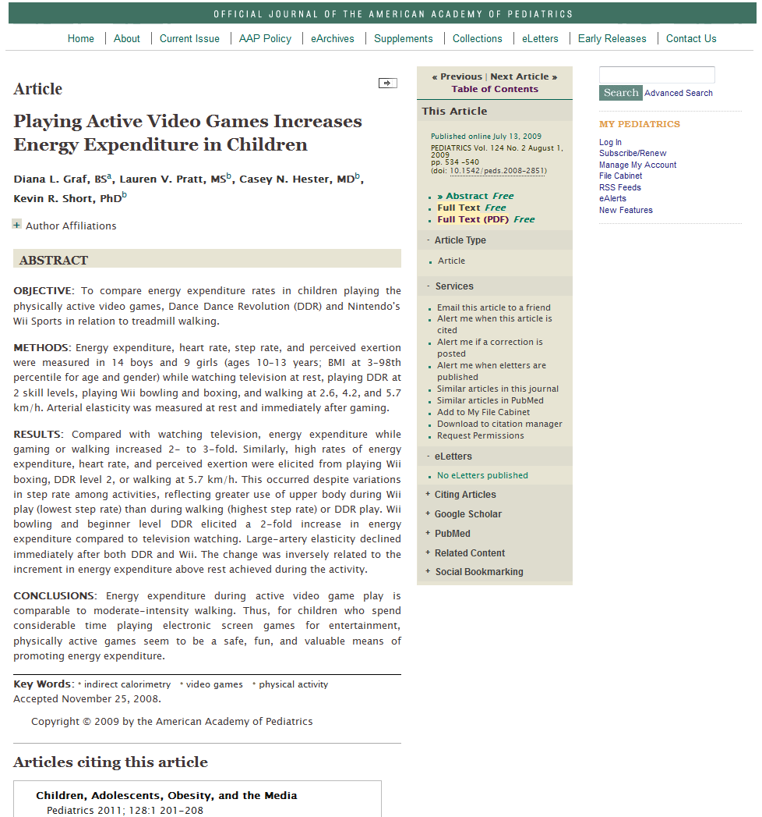
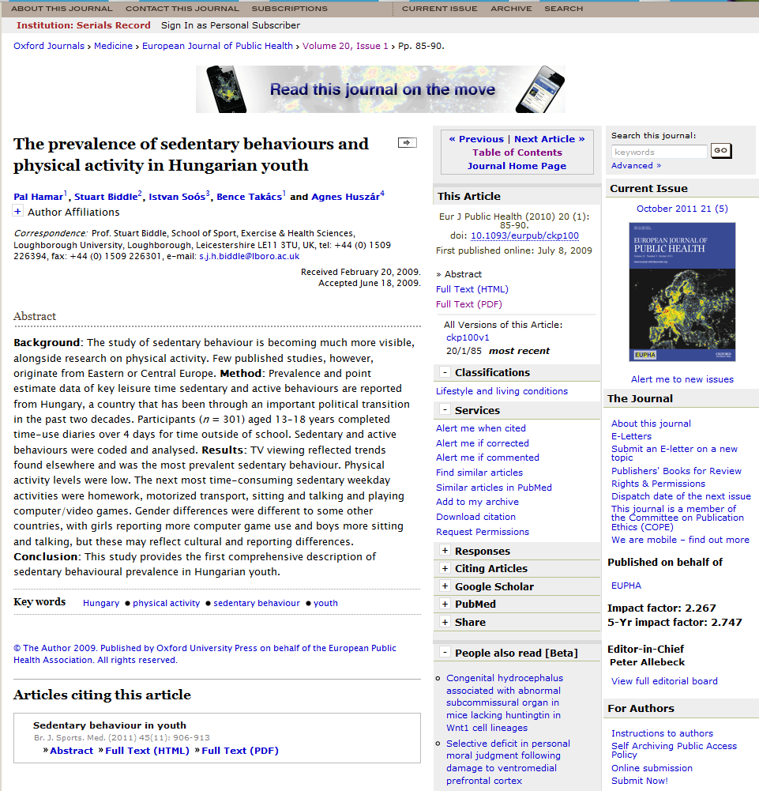
Database Screenshots
Notes:
BBI and MAE slide
Common Problems for students Using databases
Expectation that the entire article would be included on the main page
Unfamiliar with terms abstract, full text and pdf
Full text links in small fonts, often same color of text
Location – mostly right-hand frame

Slide 14
What we would like to see
Click Here
for Whole Article
Notes:
Both of us ☺

Slide 15
Findings
Keep instructions simple
Using screen capture is really fun
You will discover new links and new ways to print
You will be able to tell if the student was “trying” or not
Notes:
Both of us
Keep instructions simple:
On the computer screen is a list of scholarly journal articles from a ProQuest search on “video games” AND “boys”. Please examine the list and identify 5 articles that would most help you write a research paper on video games and violence in boys. Print a copy of each article in its entirety.
Please double click on this web page URL and print the entire article of Title. Click the End Task button when you have finished.
Screen capture is fun:
voyeurism
end up rooting for students
Frustrated mouse circles – the mouse drop
You will see links you never realized were on the web page
Printing options – many ways to print off of the same page, highlighting and printing “selection only”
Marked distinctions between printing the abstract immediately and scrolling down the page

Slide 16
Discussion
What kinds of questions related to databases do you get all of the time?
Can instruction make things better? Ideas for how?
How do we reach students who don't get instruction? Tutorials? Online reference?
Do we need to do a better job of lobbying database vendors and asking for consistency?
Would you use the databases or Google to do research?
Notes:
Both of us

Slide 17
Contact Information
Bonnie Imler
Michelle Eichelberger
bbi1@psu.edu
maeichelberger@genesee.edu

